Slide 1


Logical Agents
Assistant Professor
IT-ICT Department, LJIET
prayag.patel@ljinstitutes.edu.in
Mr. Prayag Patel

Slide 2
Outline
Knowledge–based agents
The Wumpus world
Logic
Propositional logic
Propositional theorem proving
Effective propositional model checking
Agents based on propositional logic
Mr. Prayag Patel
Department: IT/ICT-LJIET

Slide 3
Knowledge Based Agents
Mr. Prayag Patel

Slide 4
Knowledge Based Agents
Knowledge is the basic element for a human brain to know and understand the things logically.
When a person becomes knowledgeable about something, he is able to do that thing in a better way.
In AI, the agents which copy such an element of human beings are known as knowledge-based agents.
A knowledge base is a set of representations of facts of the world.
Each individual representation is called a sentence.
The sentences are expressed in a knowledge representation language.
Mr. Prayag Patel
Department: IT/ICT-LJIET

Slide 5
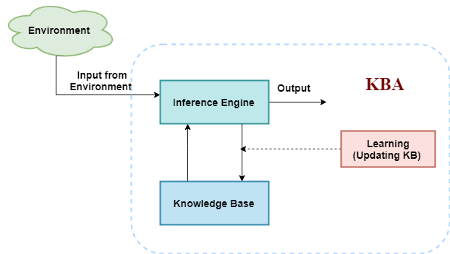
Knowledge Based Agents
Inference Engine: It is the engine of a knowledge-based system which allows to infer new knowledge in the system.
knowledge base is a set of representations of facts of the world.
Architecture for a knowledge-based agent
Mr. Prayag Patel
Department: IT/ICT-LJIET

Slide 6
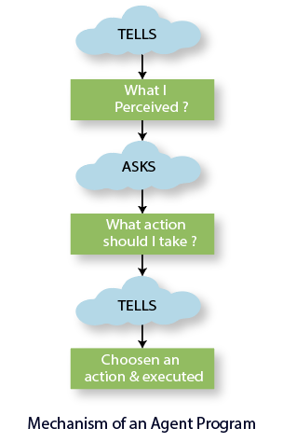
Knowledge Based Agents
The agent operates as follows:
  It TELLs the knowledge base what it perceives(Understood).(Way to add new sentences to the knowledge base).
  It ASKs the knowledge base what action it should perform. (Way to query what is known).
  It TELLs the action which is chosen, and finally, the agent executes that action.
Mr. Prayag Patel
Department: IT/ICT-LJIET

Slide 7
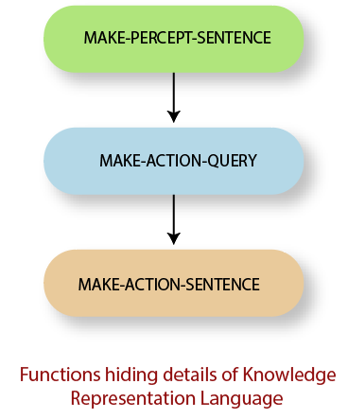
Knowledge Based Agents
function KB-AGENT(percept):
persistent: KB, a knowledge base
t, a counter, initially 0, indicating time
TELL(KB, MAKE-PERCEPT SENTENCE(percept, t))
Action = ASK(KB, MAKE-ACTION-QUERY(t))
TELL(KB, MAKE-ACTION-SENTENCE(action, t))
t = t + 1
return action
The MAKE-PERCEPT-SENTENCE generates a sentence as setting that the agent perceived the given percept at the given time.
The MAKE-ACTION-QUERY generates a sentence to ask which action should be done at the current time.
MAKE-ACTION-SENTENCE generates a sentence which asserts that the chosen action was executed.
Mr. Prayag Patel
Department: IT/ICT-LJIET

Slide 8
Knowledge Based Agents
Levels of a Knowledge-based agent
Knowledge Level: In this level, the behavior of an agent is decided by specifying the following :
  The agent’s current knowledge it has perceived.
  The goal of an agent.
Implementation Level: This level is the physical representation of the knowledge level. Here, it is understood that “how the knowledge-based agent actually implements its stored knowledge.”
For example, Consider an automated air conditioner. The inbuilt knowledge stored in its system is that “ It would adjust its temperature according to the weather.” This represents the knowledge level of the agent. The actual working and its adjustment define the implementation level of the knowledge-based agent.
Mr. Prayag Patel
Department: IT/ICT-LJIET

Slide 9
Knowledge Based Agents
Approaches used to build a Knowledge-based agent System:
Declarative Approach: Feeding the necessary information in an empty knowledge-based system. Such type of approach is used to design a knowledge-based system. The agent designer TELLS sentences to the empty system one by one until the system becomes knowledgeable enough to deal with the environment.
Procedural Approach: In this approach, knowledge is stored into an empty system in the form of program code. It is a contrasting approach to the declarative approach. It designs the behavior of the system via coding.
Mr. Prayag Patel
Department: IT/ICT-LJIET

Slide 10
The Wumpus world
Mr. Prayag Patel

Slide 11
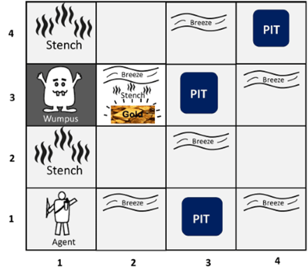
The Wumpus world
The Wumpus computer game.
The Wumpus world is a simple world example to illustrate the use of a knowledge-based agent.
The Wumpus world is a cave which has 4/4 rooms connected with passageways.
So there are total 16 rooms which are connected with each other.
We have a knowledge-based agent who will go forward in this world.
The cave has a room with a beast which is called Wumpus, who eats anyone who enters the room.
Mr. Prayag Patel
Department: IT/ICT-LJIET

Slide 12
The Wumpus world
The Wumpus can be shot by the agent, but the agent has a single arrow.
In the Wumpus world, there are some Pits rooms which are bottomless, and if agent falls in Pits, then he will be stuck there forever.
The exciting thing with this cave is that in one room there is a possibility of finding a heap of gold.
So the agent goal is to collect the gold and exit the world without fallen into Pits or eaten by Wumpus.
The agent will get a reward if he comes out with gold, and he will get a penalty if eaten by Wumpus or falls in the pit.
Mr. Prayag Patel
Department: IT/ICT-LJIET

Slide 13
The Wumpus world
Following is a sample diagram for representing the Wumpus world.
It is showing some rooms with Pits, one room with Wumpus and one agent at (1, 1) square location of the world.
Mr. Prayag Patel
Department: IT/ICT-LJIET

Slide 14
The Wumpus world
There are also some components which can help the agent to navigate the cave. These components are given as follows:
The rooms adjacent to the Wumpus room are smelly, so that it would have some stench(smell).
The room adjacent to PITs has a breeze, so if the agent reaches near to PIT, then he will perceive the breeze.
There will be glitter(shine with a bright) in the room if and only if the room has gold.
The Wumpus can be killed by the agent if the agent is facing to it, and Wumpus will emit a horrible scream which can be heard anywhere in the cave.
Mr. Prayag Patel
Department: IT/ICT-LJIET

Slide 15
The Wumpus world
PEAS description of Wumpus world:
Performance measure:
+1000 reward points if the agent comes out of the cave with the gold.
-1000 points penalty for being eaten by the Wumpus or falling into the pit.
-1 for each action, and -10 for using an arrow.
The game ends if either agent dies or came out of the cave.
Mr. Prayag Patel
Department: IT/ICT-LJIET

Slide 16
The Wumpus world
PEAS description of Wumpus world:
Environment:
A 4*4 grid of rooms.
The agent initially in room square [1, 1], facing toward the right.
Location of Wumpus and gold are chosen randomly except the first square [1,1].
Each square of the cave can be a pit with probability 0.2 except the first square.
Mr. Prayag Patel
Department: IT/ICT-LJIET

Slide 17
The Wumpus world
PEAS description of Wumpus world:
3) Actuators :
Left turn (90 degree)
Right turn (90 degree)
Move forward
Grab (Pick up an object )
Release
Shoot (Fire an Arrow)
Mr. Prayag Patel
Department: IT/ICT-LJIET

Slide 18
The Wumpus world
PEAS description of Wumpus world:
4) Sensors :
The agent will perceive the stench if he is in the room adjacent to the Wumpus. (Not diagonally).
The agent will perceive breeze if he is in the room directly adjacent to the Pit.
The agent will perceive the glitter in the room where the gold is present.
The agent will perceive the bump if he walks into a wall.
When the Wumpus is shot, it emits a horrible scream which can be perceived anywhere in the cave.
These percepts can be represented as five element list, in which we will have different indicators for each sensor.
Example if agent perceives stench, breeze, but no glitter, no bump, and no scream then it can be represented as:
[Stench, Breeze, None, None, None].
[Stench, Breeze, Glitter, bump, scream].
Department: IT/ICT-LJIET
Mr. Prayag Patel

Slide 19
The Wumpus world
Wumpus Goal:
The agent’s goal is to find the gold and bring it back to the start square as quickly as possible, without getting killed.
Mr. Prayag Patel
Department: IT/ICT-LJIET

Slide 20
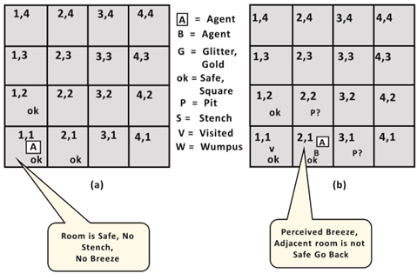
The Wumpus world
Exploring the Wumpus world:
Agent’s First step:
[Stench, Breeze, Glitter, bump, scream].
Initially, the agent is in the first room or on the square [1,1], and we already know that this room is safe for the agent, so to represent on the below diagram (a) that room is safe we will add symbol OK.
Symbol A is used to represent agent
symbol B for the breeze
G for Glitter or gold
V for the visited room
P for pits
W for Wumpus.
Breeze
At Room [1,1] agent does not feel any breeze or any Stench which means the adjacent squares are also OK.
[None, None, None, None, None].
Mr. Prayag Patel
Department: IT/ICT-LJIET

Slide 21
The Wumpus world
Agent’s Second step:
[Stench, Breeze, Glitter, bump, scream].
Now agent needs to move forward, so it will either move to [1, 2], or [2,1].
Let's suppose agent moves to the room [2, 1], at this room agent perceives some breeze which means Pit is around this room. The pit can be in [3, 1], or [2,2], so we will add symbol P? to say that, is this Pit room?
Now agent will stop and think and will not make any harmful move. The agent will go back to the [1, 1] room. The room [1,1], and [2,1] are visited by the agent, so we will use symbol V to represent the visited squares.
Breeze
Mr. Prayag Patel
Department: IT/ICT-LJIET
[None, None, None, None, None].
[None, Breeze, None, None, None].

Slide 22
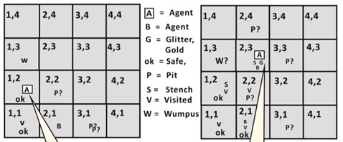
The Wumpus world
Agent’s Third step:
At the third step, now agent will move to the room [1,2] which is OK.
In the room [1,2] agent perceives a stench which means there must be a Wumpus nearby. But Wumpus cannot be in the room [1,1] as by rules of the game, and also not in [2,2] (Agent had not detected any stench when he was at [2,1]).
Therefore agent infers that Wumpus is in the room [1,3], and in current state, there is no breeze which means in [2,2] there is no Pit and no Wumpus. So it is safe, and we will mark it OK, and the agent moves further in [2,2].
[Stench, Breeze, Glitter, bump, scream].
[Stench, None, None, None, None].
[None, None, None, None, None].
Breeze
S
ok
A
Mr. Prayag Patel
Department: IT/ICT-LJIET

Slide 23
The Wumpus world
Agent’s Fourth step:
[Stench, Breeze, Glitter, bump, scream].
At room [2,2], here no stench and no breezes present so let's suppose agent decides to move to [2,3].
At room [2,3] agent perceives glitter, so it should grab the gold and climb out of the cave.
[Stench, Breeze, Glitter, None, None].
Breeze
Mr. Prayag Patel
Department: IT/ICT-LJIET

Slide 24
LOGIC
Mr. Prayag Patel

Slide 25
Logic
Logics are formal languages for representing information such that conclusions can be drawn.
Logic: Way of representing facts.
Logic can be defined as the proof or validation behind any reason provided.
A Logic must also define the semantics or meaning of sentences.
Mr. Prayag Patel
Department: IT/ICT-LJIET

Slide 26
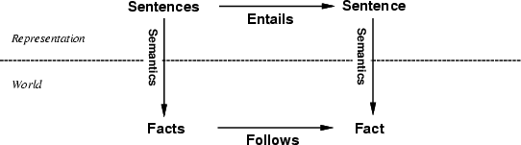
Logic
Syntax which defines all possible sequences of symbols that constitute sentences of the language.
The atomic symbols used in the language and how they can be composed to formal legal sentences.
Semantics define the “meaning” of sentences; i.e., define truth of a sentence in a world.
What fact about the world is represented by a sentence in the language, which determines whether it is true or false.
Mr. Prayag Patel
Department: IT/ICT-LJIET

Slide 27
Logic
E.g., the language of arithmetic
x + 2 ≥ y is a sentence; x2 + y > is not a sentence.
x + 2 ≥ y is true if the number x + 2 is no less than the number y
x + 2 ≥ y is true in a world where x = 7, y = 1
x + 2 ≥ y is false in a world where x = 0, y = 6
Mr. Prayag Patel
Department: IT/ICT-LJIET

Slide 28
Logic: Entailment
Entailment is a concept that refers to a specific kind of relationship between two sentences. (One thing follows from another.)
More specifically, entailment means that if one sentence is true, then another sentence would also have to be true: the second sentence would be entailed by the first sentence.
E.g. Statement A: "I will turn 28 this year;“
Statement B: "I am currently living."
Entailment is present here because the truth of A requires the truth of B: if I am not currently living, then I cannot age, and therefore I will not turn 28 this year.
The truth of A requires the truth of B
A ⊨ B means Statement A entailment Statement B
(If A is true then B is also true)
Mr. Prayag Patel
Department: IT/ICT-LJIET

Slide 29
Logic: Entailment
Entailment means that one thing follows from another:
KB ⊨ α
means that Knowledge base KB entails sentence α
if and only if α is true in all worlds where KB is true
(If KB is true then α is also true)
E.g., x + y = 4 entails 4 = x + y
Entailment is a relationship between sentences (i.e., syntax) that is based on semantics.
Mr. Prayag Patel
Department: IT/ICT-LJIET

Slide 30
Logic: Models
Logicians typically think in terms of models, which are formally structured worlds with respect to which truth can be evaluated
We say m is a model of a sentence α if α is true in m
M (α) is the set of all models of α
Then KB ⊨ α if and only if M (KB) ⊆ M (α)
(If KB is true then α is also true)
E.g. KB = Giants won and Reds won
α = Giants won
x
x x
x
M(α)
x
x
_{x} x
x
x
x
x
x
x
x x
x
x
x
x
x
x
x
x
x
x
x
x x
xx
_{x} x xx x
x x
x
x
M(KB)
x
x
x
x
x
x
x
Mr. Prayag Patel
Department: IT/ICT-LJIET

Slide 31
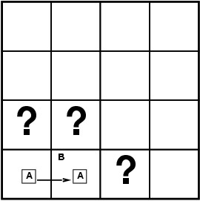
Logic: Entailment in the Wumpus World
Situation after detecting nothing in [1,1], moving right, breeze in [2,1]
Consider possible models for KB assuming only pits
3 Boolean choices then 8 possible models
Mr. Prayag Patel
Department: IT/ICT-LJIET

Slide 32
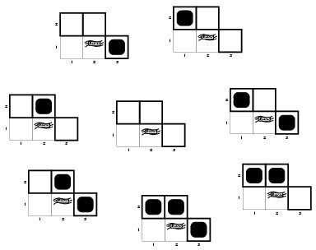
Logic: Wumpus Models
3 Boolean choices then 8 possible models
Mr. Prayag Patel
Department: IT/ICT-LJIET

Slide 33
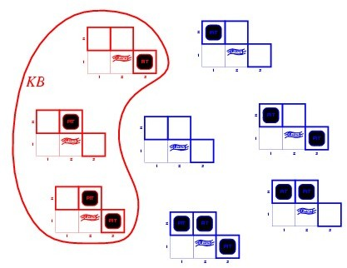
Logic: Wumpus Models
KB = Nothing in [1,1] and Breeze in [2,1]
= wumpus-world rules + observations
Mr. Prayag Patel
Department: IT/ICT-LJIET

Slide 34
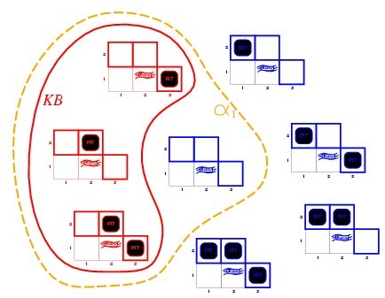
Logic: Wumpus Models
KB = Nothing in [1,1] and Breeze in [2,1] = wumpus-world rules + observations
α₁ = "[1,2] is safe(no Pit in "[1,2]) ”, KB╞ α₁, proved by model checking
enumerate all possible models to check that α₁ is true in all models in which KB is true
Mr. Prayag Patel
Department: IT/ICT-LJIET

Slide 35
Logic: Wumpus Models
KB = Nothing in [1,1] and Breeze in [2,1]
= wumpus-world rules + observations
Mr. Prayag Patel
Department: IT/ICT-LJIET

Slide 36
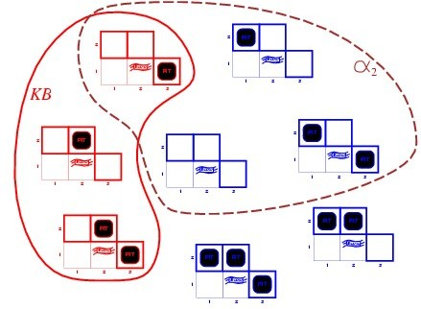
Logic: Wumpus Models
KB = Nothing in [1,1] and Breeze in [2,1] = wumpus-world rules + observations
α₂ = "[2,2] is safe(no Pit in [2,2]) ”, KB╞ α₂, Not True
so KB╞ α₁ (no Pit in "[1,2]) is True But KB╞ α₂ (no Pit in [2,2]) is False
Mr. Prayag Patel
Department: IT/ICT-LJIET

Slide 37
Logic: Inference
Logical inference (deduction): derives new sentences in the language from existing ones.
Socrates is a man.
All men are mortal.
--------------------------
Socrates is mortal.
Proper inference should only derive sound conclusions. (ones that are true assuming the premises are true)
Mr. Prayag Patel
Department: IT/ICT-LJIET

Slide 38

Logic: Inference
KB ⊢_{i} α = sentence α can be derived from KB by procedure i
Consequences of KB are a haystack; α is a needle.
Entailment = needle in haystack; inference = finding it
Soundness: An inference algorithm that derives only entailed sentences is called sound. (no wrong inferences, but maybe not all inferences)
i is sound if whenever KB ⊢_{i} α, it is also true that KB ⊨ α
Completeness: An inference algorithm is complete if it can derive any sentence that is entailed.(all inferences can be made, but maybe some wrong extra ones as well)
i is complete if whenever KB ⊨ α, it is also true that KB ⊢_{i} α
Mr. Prayag Patel
Department: IT/ICT-LJIET

Slide 39
Propositional logic
Mr. Prayag Patel

Slide 40
Propositional logic
Propositional logic is the simplest logic – illustrates basic ideas.
Propositional logic (PL) is the simplest form of logic where all the statements are made by propositions.
A proposition is a declarative statement which is either true or false.
It is a technique of knowledge representation in logical and mathematical form.
Example:
a) It is Sunday.
b) The Sun rises from West (False proposition)
c) 3+3= 7(False proposition)
d) 5 is a prime number.
Mr. Prayag Patel
Department: IT/ICT-LJIET

Slide 41
Propositional logic
Basic facts about propositional logic:
Propositional logic is also called Boolean logic as it works on 0 and 1.
In propositional logic, we use symbolic variables to represent the logic, and we can use any symbol for a representing a proposition, such A, B, C, P, Q, R, etc.
Propositions can be either true or false, but it cannot be both.
Propositional logic consists of an object, relations or function, and logical connectives.
These connectives are also called logical operators.
The propositions and connectives are the basic elements of the propositional logic.
Mr. Prayag Patel
Department: IT/ICT-LJIET

Slide 42
Propositional logic
Basic facts about propositional logic:
Connectives can be said as a logical operator which connects two sentences.
A proposition formula which is always true is called tautology, and it is also called a valid sentence.
A proposition formula which is always false is called Contradiction.
A proposition formula which has both true and false values is called.
Statements which are questions, commands, or opinions are not propositions such as "Where is Rohini", "How are you", "What is your name", are not propositions.
Mr. Prayag Patel
Department: IT/ICT-LJIET

Slide 43
Propositional logic
Syntax of propositional logic:
The syntax of propositional logic defines the allowable sentences for the knowledge representation.
The atomic symbols used in the language and how they can be composed to formal legal sentences.
There are two types of Propositions:
  Atomic Propositions
  Compound propositions
Atomic Proposition: Atomic propositions are the simple propositions. It consists of a single proposition symbol. These are the sentences which must be either true or false.
Example:
  a) 2+2 is 4, it is an atomic proposition as it is a true fact.
  b) "The Sun is cold" is also a proposition as it is a false fact.
Mr. Prayag Patel
Department: IT/ICT-LJIET

Slide 44
Propositional logic
Syntax of propositional logic:
Compound proposition: Compound propositions are constructed by combining simpler or atomic propositions, using parenthesis and logical connectives.
Example:
  a) "It is raining today, and street is wet."
b) "Ankit is a doctor, and his clinic is in Mumbai."
Mr. Prayag Patel
Department: IT/ICT-LJIET

Slide 45
Propositional logic
Syntax of propositional logic:
Logical constants: True, False
Propositional symbols: P, Q, S₁, S₂ etc. representing specific facts about the world
The proposition symbols S₁, S₂ etc are sentences.
If S is a sentence, then (S) is a sentence
If S is a sentence, ¬S is a sentence (negation)
If S₁ and S₂ are sentences, S₁ ∧ S₂ is a sentence (conjunction)
If S₁ and S₂ are sentences, S₁ ∨ S₂ is a sentence (disjunction)
If S₁ and S₂ are sentences, S₁ ⇒ S₂ is a sentence (implication) (if P then Q means if P is true then I am claiming that Q is true)
If S₁ and S₂ are sentences, S₁ ⇔ S₂ is a sentence (biconditional)
Mr. Prayag Patel
Department: IT/ICT-LJIET

Slide 46
Propositional logic
Precedence of connectives:
Just like arithmetic operators, there is a precedence order for propositional connectors or logical operators.
Precedence | Operators
First Precedence | Parenthesis
Second Precedence | Negation
Third Precedence | Conjunction(AND)
Fourth Precedence | Disjunction(OR)
Fifth Precedence | Implication
Six Precedence | Biconditional
Ex: -2 + 4 is 2, not -6
Such as ¬R∨ Q, It can be interpreted as (¬R) ∨ Q.
Mr. Prayag Patel
Department: IT/ICT-LJIET

Slide 47
Propositional logic
Semantics of propositional logic:
Semantics define the “meaning” of sentences; i.e., define truth of a sentence in a world.
What fact about the world is represented by a sentence in the language, which determines whether it is true or false.
True and False indicate truth and falsity in the world
A proposition denotes whatever fixed statement about the world you want which could be true or false.
Each model specifies true/false for each proposition symbol
Mr. Prayag Patel
Department: IT/ICT-LJIET

Slide 48
Propositional logic
Semantics of propositional logic:
Each model specifies true/false for each proposition symbol
Rules for evaluating truth with respect to a model m:
¬S | is true iff | S |  | is false
S₁ ∧ S₂ | is true iff | S₁ |  | is true and | S₂ |  | is true
S₁ ∨ S₂ | is true iff | S₁ |  | is true or | S₂ |  | is true
S₁ ⇒ S₂ | is true iff | S₁ |  | is false or | S₂ |  | is true
i.e., | is false iff | S₁ |  | is true and | S₂ |  | is false
S₁ ⇔ S₂ | is true iff | S₁ ⇒ | S₂ | is true and | S₂ ⇒ | S₁ | is true
Mr. Prayag Patel
Department: IT/ICT-LJIET

Slide 49
Propositional logic
Semantics of propositional logic:
Truth table for Connectives :
P | Q | ¬P | P ∧ Q | P ∨ Q | P ⇒Q | P ⇔Q
false | false | true | false | false | true | true
false | true | true | false | true | true | false
true | false | false | false | true | false | false
true | true | false | true | true | true | true
Mr. Prayag Patel
Department: IT/ICT-LJIET

Slide 50
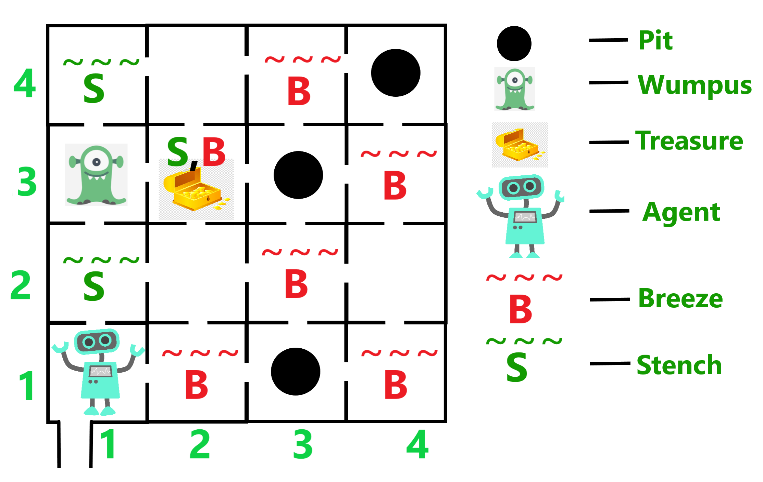
Propositional logic
A simple Knowledge base - Wumpus World Sentences:
Let P_{i,j} be true if there is a pit in [i, j].
Let B_{i,j} be true if there is a breeze in [i, j].
      R₁: ¬P_{1,1}
      “Pits cause breezes in adjacent squares”
      R₂ : B_{1,1} ⇔ (P_{1,2} ∨ P_{2,1})
      R₃ : B_{2,1} ⇔ (P_{1,1} ∨ P_{2,2} ∨ P_{3,1} )
      R₄ : ¬B_{1,1}
      R₅ : B_{2,1}
Mr. Prayag Patel
Department: IT/ICT-LJIET

Slide 51
Propositional logic
A Sample Inference Procedure: Truth Table
The KB consists of the above 5 sentences. It can also be considered as a single sentence – the conjunction R1 ∧ R2 ∧ R3 ∧ R4 ∧ R5
B1,1 | B2,1 | P1,1 | P1,2 | P2,1 | P2,2 | P3,1 | R₁ | R₂ | R₃ | R₄ | R₅ | KB
false false . false | false false . true | false false . false | false false . false | false false . false | false false . false | false true . false | true true . true | true true . true | true false . false | true true . true | false false . true | false false . false
false false false | true true true | false false false | false false false | false false false | false true true | true false true | true true true | true true true | true true true | true true true | true true true | true true true
false . . True | true . . true | false . . true | false . . true | true . . true | false . . true | false . . true | true . . false | false . . true | false . . true | true . . false | true . . true | false . . false
Mr. Prayag Patel
Department: IT/ICT-LJIET

Slide 52
Propositional logic
A Sample Inference Procedure: Truth Table
KB is true if R1 through R5 are true, which occurs in just 3 of the 128 rows (the ones underlined in the right-hand column).
In all 3 rows, P1,2 is false, so there is no pit in [1,2]. On the other hand, there might (or might not) be a pit in [2,2].
B1,1 | B2,1 | P1,1 | P1,2 | P2,1 | P2,2 | P3,1 | R₁ | R₂ | R₃ | R₄ | R₅ | KB
false false . false | false false . true | false false . false | false false . false | false false . false | false false . false | false true . false | true true . true | true true . true | true false . false | true true . true | false false . true | false false . false
false false false | true true true | false false false | false false false | false false false | false true true | true false true | true true true | true true true | true true true | true true true | true true true | true true true
false . True | true . true | false . true | false . true | true . true | false . true | false . true | true . false | false . true | false . true | true . false | true . true | false . false
Mr. Prayag Patel
Department: IT/ICT-LJIET

Slide 53
Propositional logic
A Sample Inference Procedure: Enumeration Algorithm
Depth-first enumeration of all models is sound and complete
function TT-Entails?(KB, α) returns true or false
inputs: KB, the knowledge base, a sentence in propositional logic
α, the query, a sentence in propositional logic
symbols ← a list of the proposition symbols in KB and α
return TT-Check-All(KB, α, symbols, [ ])
function TT-Check-All(KB, α, symbols, model) returns true or false
if Empty?(symbols) then
if PL-True?(KB, model) then return PL-True?(α, model)
else return true
else do
P ← First(symbols);
rest ← Rest(symbols)
return TT-Check-All(KB, α, rest, Extend(P , true, model )) and
TT-Check-All(KB, α, rest, Extend(P , false, model ))
Mr. Prayag Patel
Department: IT/ICT-LJIET

Slide 54
Propositional theorem proving
Inference and Proofs
Assistant Professor
IT-ICT Department, LJIET
prayag.patel@ljinstitutes.edu.in
Mr. Prayag Patel

Slide 55
Propositional theorem proving
So far We have shown how to determine entailment by model checking.
Now We show how entailment can be done by Theorem Proving.
Theorem proving: Applying rules of inference directly to the sentences in our knowledge base to construct a proof of the desired sentence without consulting models.
If the number of models is large but the length of the proof is short, then theorem proving can be more efficient than model checking.
Mr. Prayag Patel
Department: IT/ICT-LJIET

Slide 56
Propositional theorem proving
Before starting theorem proving, we will need some additional concepts related to entailment.
Logical Equivalence
Validity
Satisfiability
Mr. Prayag Patel
Department: IT/ICT-LJIET

Slide 57
Propositional theorem proving
1) Logical Equivalence
Two sentences are logically equivalent iff they are true in the same models: α ≡ ß iff α╞ β and β╞ α (both entailment)
(α ∧ β) | ≡ | (β ∧ α) commutativity of ∧
(α ∨ β) | ≡ | (β ∨ α) commutativity of ∨
((α ∧ β) ∧ γ) | ≡ | (α ∧ (β ∧ γ)) associativity of ∧
((α ∨ β) ∨ γ) | ≡ | (α ∨ (β ∨ γ)) associativity of ∨
¬(¬α) | ≡ | α double-negation elimination
(α ⇒ β) | ≡ | (¬β ⇒ ¬α) contraposition
Mr. Prayag Patel
Department: IT/ICT-LJIET

Slide 58
Propositional theorem proving
1) Logical Equivalence
(α ⇒ β) | ≡ | (¬α ∨ β) implication elimination
(α ⇔ β) | ≡ | ((α ⇒ β) ∧ (β ⇒ α)) biconditional elimination
¬(α ∧ β) | ≡ | (¬α ∨ ¬β) De Morgan
¬(α ∨ β) | ≡ | (¬α ∧ ¬β) De Morgan
(α ∧ (β ∨ γ)) | ≡ | ((α ∧ β) ∨ (α ∧ γ)) distributivity of ∧ over ∨
(α ∨ (β ∧ γ)) | ≡ | ((α ∨ β) ∧ (α ∨ γ)) distributivity of ∨ over ∧
Mr. Prayag Patel
Department: IT/ICT-LJIET

Slide 59
Propositional theorem proving
2) Validity
A sentence is valid if it is true in all models.
E.g., True, A ∨ ¬A, A ⇒ A, (A ∧ (A ⇒ B)) ⇒ B
Valid sentences are also known as tautologies they are necessarily true. Every valid sentence is logically equivalent to True.
The deduction theorem: For any sentence α and β, α ⊨ β if and only if the sentence (α ⇒ β) is valid.
Mr. Prayag Patel
Department: IT/ICT-LJIET

Slide 60
Propositional theorem proving
3) Satisfiability
A sentence is satisfiable if it is true in some model
  e.g., A ∨ B, C
A sentence is unsatisfiable if it is true in no models
  e.g., A ∧ ¬ A
The SAT problem: The problem of determining the satisfiability of sentences in propositional logic.
  e.g., Constraint satisfaction problem.
Mr. Prayag Patel
Department: IT/ICT-LJIET

Slide 61
Propositional theorem proving
Validity and satisfiability are connected:
α is valid iff ¬α is unsatisfiable;
α is satisfiable iff ¬α is not valid;
α ⊨ β if and only if the sentence (α ∧ ¬β) is unsatisfiable.
Proving β from α by checking the satisfiability of (α ∧ ¬β) corresponds to proof by contradiction.
Mr. Prayag Patel
Department: IT/ICT-LJIET

Slide 62
Inference and Proofs
Proof methods:
Application of inference rules
Legitimate (sound) generation of new sentences from old
Proof = a sequence of inference rule applications
Can use inference rules as operators in a standard search algorithm.
Typically require translation of sentences into a normal form
Mr. Prayag Patel
Department: IT/ICT-LJIET

Slide 63
Inference and Proofs
Proof methods:
2) Model checking
Truth table enumeration (always exponential in n)
Improved backtracking, e.g., Davis–Putnam–Logemann–Loveland heuristic search in model space (sound but incomplete)
e.g., hill-climbing algorithms
Mr. Prayag Patel
Department: IT/ICT-LJIET

Slide 64
Inference and Proofs
In artificial intelligence, we need intelligent computers which can create new logic from old logic or by evidence, so generating the conclusions from evidence and facts is termed as Inference.
Inference rules are the templates for generating valid arguments.
Inference rules are applied to derive proofs in artificial intelligence, and the proof is a sequence of the conclusion that leads to the desired goal.
Mr. Prayag Patel
Department: IT/ICT-LJIET

Slide 65
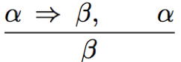
Inference and Proofs
Types of Inference rules:
Modus Ponens:
The Modus Ponens rule is one of the most important rules of inference, and it states that if α and α ⇒ β is true, then we can infer that β will be true. It can be represented as:
Whenever any sentences of the form α⇒β and α are given, then the sentence β can be inferred.
Mr. Prayag Patel
Department: IT/ICT-LJIET

Slide 66
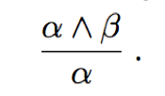
Inference and Proofs
Types of Inference rules:
2) And-Elimination:
And- Elimination rule state that if α ∧ β is true, then α or β will also be true. It can be represented as:
From a conjunction, any of the conjuncts can be inferred.
Mr. Prayag Patel
Department: IT/ICT-LJIET

Slide 67
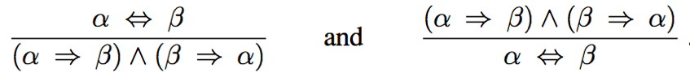
Inference and Proofs
All of logical equivalence can be used as inference rules.
(α ⇔ β) | ≡ | ((α ⇒ β) ∧ (β ⇒ α)) biconditional elimination
Mr. Prayag Patel
Department: IT/ICT-LJIET

Slide 68
Inference and Proofs
Let us see how these inference rules and equivalences can be used in the wumpus world.
We start with the knowledge base containing R₁ through R₅ and show how to prove ￢ P_{1,2} that is, there is no pit in [1,2].
      R₁: ¬P_{1,1}
      R₂ : B_{1,1} ⇔ (P_{1,2} ∨ P_{2,1})
      R₃ : B_{2,1} ⇔ (P_{1,1} ∨ P_{2,2} ∨ P_{3,1} )
      R₄ : ¬B_{1,1}
      R₅ : B_{2,1}
First, we apply biconditional elimination to R₂ to obtain
R₆ : (B_{1,1} ⇒ (P_{1,2} ∨ P_{2,1})) ∧ ((P_{1,2} ∨ P_{2,1}) ⇒ B_{1,1})
Mr. Prayag Patel
Department: IT/ICT-LJIET

Slide 69
Inference and Proofs
Then we apply And-Elimination to R6 to obtain
R₇: ((P_{1,2} ∨ P_{2,1}) ⇒ B_{1,1})
Logical equivalence for contrapositives gives
R₈: (￢B_{1,1} ⇒ ￢(P_{1,2} ∨ P_{2,1}))
Now we can apply Modus Ponens with R8 and the percept R4 (i.e., ￢B1,1), to obtain
      R₄ : ¬B_{1,1}
R₉ : ￢(P_{1,2} ∨ P_{2,1})
Finally, we apply De Morgan’s rule, giving the conclusion
R₁₀ : ￢P_{1,2} ∧ ￢ P_{2,1}
That is neither [1,2] nor [2,1] contains a pit.
Mr. Prayag Patel
Department: IT/ICT-LJIET

Slide 70
Inference and Proofs
Define Proof Problem as search problem:
Initial state: initial knowledge base
Actions: set of actions consists of all the inference rules applied to all the sentences that match the left half of the inference rule
Result: add the sentence in the right half of the inference rule
Goal: the goal is a state that contains the sentence we are trying to prove
Practically, finding a proof can be more efficient because the proof can ignore irrelevant propositions, no matter how many of them there are
Mr. Prayag Patel
Department: IT/ICT-LJIET

Slide 71
Inference and Proofs
Monotonicity: A property of logical system, says that the set of entailed sentences can only increased as information is added to the knowledge base.
For any sentences α and β,
If KB ⊨ α then KB ∧β ⊨ α.
Monotonicity means that inference rules can be applied whenever suitable premises are found in the knowledge base, what else in the knowledge base cannot invalidate any conclusion already inferred.
Mr. Prayag Patel
Department: IT/ICT-LJIET

Slide 72
Propositional theorem proving
Proof by resolution
Assistant Professor
IT-ICT Department, LJIET
prayag.patel@ljinstitutes.edu.in
Mr. Prayag Patel

Slide 73
Proof by resolution
Resolution is a theorem proving technique that proceeds by building refutation proofs, i.e., proofs by contradictions
The inference rules can be applied whenever suitable premises are found in the KB.
The conclusion of the rule must follow regardless of what else is in the KB.
The above rules are sound, but if the available inference rules are inadequate, then it’s not complete.
Now, we introduce a single inference rule, resolution, that gives a complete inference algorithm when coupled with any complete search algorithm
Mr. Prayag Patel
Department: IT/ICT-LJIET

Slide 74
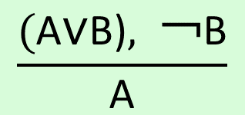
Proof by resolution
Resolution: An inference rule that yields a complete inference algorithm when coupled with any complete search algorithm.(Theorem proving technique that proceed proof by contradictions.)
Clause: A clause is an expression of the form A₁ ∨ A₂ ∨ A₃ ∨ …. A_{n} where A_{i} is a Literal. A disjunction of literals. (e.g. A ∨ B). A single literal can be viewed as a unit clause (a disjunction of one literal ).
Literal: A Literal is an assignment of a value to a Boolean variable.
Unit resolution inference rule: Takes a clause and a literal and produces a new clause.
$$\frac{\text{(}\text{A}\text{∨}\text{B}\text{)}, \text{￢}\text{B}}{\text{A}}$$
Mr. Prayag Patel
Department: IT/ICT-LJIET

Slide 75
Proof by resolution
The inference rules covered so far are sound.
Combined with any complete search algorithm they also constitute a complete inference algorithm.
However, removing any one inference rule will lose the completeness of the algorithm.
Resolution is a single inference rule that yields a complete inference algorithm when coupled with any complete search algorithm.
Mr. Prayag Patel
Department: IT/ICT-LJIET

Slide 76
Proof by resolution
Let us consider the steps leading up to Figure : the agent returns from [2,1] to [1,1] and then goes to [1,2], where it perceives a stench, but no breeze.
We add the following facts to the knowledge base:
R11 : ￢B1,2 .
R12 : B1,2 ⇔ (P1,1 ∨ P2,2 ∨ P1,3) .
By the same process that led to R10 earlier, we can now derive the absence of pits in [2,2] and [1,3] (remember that [1,1] is already known to be pitless):
R13 : ￢P2,2 .
R14 : ￢P1,3 .
Mr. Prayag Patel
Department: IT/ICT-LJIET

Slide 77
Proof by resolution
We can also apply biconditional elimination to R₃ , followed by Modus Ponens with R₅ , to obtain the fact that there is a pit in [1,1], [2,2], or [3,1]:
      R₃ : B_{2,1} ⇔ (P_{1,1} ∨ P_{2,2} ∨ P_{3,1} )
      R₅ : B_{2,1}
R15 : P1,1 ∨ P2,2 ∨ P3,1 .
Now comes the first application of the resolution rule: the literal ￢P2,2 in R13 resolves with the literal P2,2 in R15 to give the resolvent
R13 : ￢P2,2 .
R16 : P1,1 ∨ P3,1 .
Mr. Prayag Patel
Department: IT/ICT-LJIET

Slide 78
Proof by resolution
In English; if there’s a pit in one of [1,1], [2,2], and [3,1] and it’s not in [2,2], then it’s in [1,1] or [3,1].
Similarly, the literal ￢ P1,1 in R1 resolves with the literal P1,1 in R16 to give
      R₁: ¬P_{1,1}
R17 : P3,1 .
R16 : P1,1 ∨ P3,1 .
In English: if there’s a pit in [1,1] or [3,1] and it’s not in [1,1], then it’s in [3,1].
Mr. Prayag Patel
Department: IT/ICT-LJIET

Slide 79
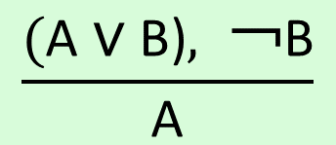
Proof by resolution
These last two inference steps are examples of the unit resolution inference rule,
$$\frac{\text{(}\text{A} \text{∨} \text{B}\text{)}, \text{￢}\text{B}}{\text{A}}$$
where each l is a literal and l i and m are complementary literals.(one is the negation of the other)
Mr. Prayag Patel
Department: IT/ICT-LJIET

Slide 80
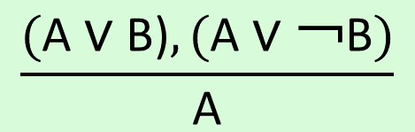
Proof by resolution
The unit resolution rule can be generalized to the full resolution rule,
where each l is a literal and l i and mj are complementary literals.(one is the negation of the other)
Factoring: The removal of multiple copies of literals is called factoring.
$$\frac{\text{(}\text{A} \text{∨} \text{B}\text{)},\text{(}\text{A} \text{∨} \text{￢}\text{B})}{\text{A}}$$
Mr. Prayag Patel
Department: IT/ICT-LJIET

Slide 81
Proof by resolution
Soundness of resolution inference rule:
  if l _{i} is true, then m_{j} is false
    hence (m₁ ∨ … ∨ m _{j-1} ∨ m _{j+1} ∨... ∨ m_{n}) must be true
  if l _{i} is false, then
    (l₁ ∨ … ∨ l _{i-1} ∨ l _{i+1} ∨ … ∨ l_{k}) must be true
Mr. Prayag Patel
Department: IT/ICT-LJIET

Slide 82
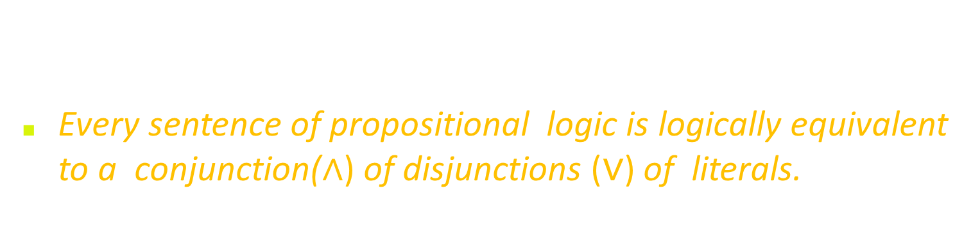
Proof by resolution
Conjunctive Normal Form(CNF):
Resolution rule applies only to disjunctions($\text{∨}$) of literals
Every sentence of propositional logic is logically equivalent to a conjunction(∧) of disjunctions ($\text{∨}$) of literals.
Conjunctive Normal Form (CNF):
  conjunction of disjunctions of literals clauses
  E.g., (A ∨ ¬B) ∧ (B ∨ ¬C ∨ ¬D)
Mr. Prayag Patel
Department: IT/ICT-LJIET

Slide 83
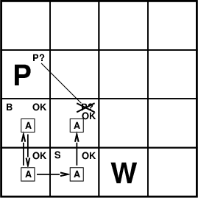
Proof by resolution
Conjunctive Normal Form(CNF):
Converting following sentence into CNF
Rules such as: “If breeze, then a pit adjacent.“
B1,1 ⇔ (P1,2 ∨ P2,1)
Mr. Prayag Patel
Department: IT/ICT-LJIET

Slide 84
Proof by resolution
Conjunctive Normal Form(CNF):
B1,1 ⇔ (P1,2 ∨ P2,1)
Eliminate ⇔, replacing α ⇔ β with (α ⇒ β) ∧ (β ⇒ α).
(B1,1 ⇒ (P1,2 ∨ P2,1)) ∧ ((P1,2 ∨ P2,1) ⇒ B1,1) .
Eliminate ⇒, replacing α ⇒ β with ￢α ∨ β:
(￢B1,1 ∨ P1,2 ∨ P2,1) ∧ (￢(P1,2 ∨ P2,1) ∨ B1,1) .
Mr. Prayag Patel
Department: IT/ICT-LJIET

Slide 85
Proof by resolution
Conjunctive Normal Form(CNF):
“move ￢ inwards” using following De Morgan’s rules and double negation rules:
￢(α ∨ β) ≡ (￢α ∧ ￢β) (De Morgan)
￢(￢α) ≡ α (double-negation elimination)
(￢B1,1 ∨ P1,2 ∨ P2,1) ∧ (￢(P1,2 ∨ P2,1) ∨ B1,1)
(￢B1,1 ∨ P1,2 ∨ P2,1) ∧ ((￢P1,2 ∧ ￢P2,1) ∨ B1,1)
Mr. Prayag Patel
Department: IT/ICT-LJIET

Slide 86
Proof by resolution
Conjunctive Normal Form(CNF):
Apply distributive law (∧ over ∨) and flatten:
(￢B1,1 ∨ P1,2 ∨ P2,1) ∧ ((￢P1,2 ∧ ￢P2,1) ∨ B1,1)
(￢B1,1 ∨ P1,2 ∨ P2,1) ∧ (￢P1,2 ∨ B1,1) ∧ (￢P2,1) ∨ B1,1)
The original sentence is now in CNF, as a conjunction of three clauses. It is much harder to read, but it can be used as input to a resolution procedure.
Mr. Prayag Patel
Department: IT/ICT-LJIET

Slide 87
Proof by resolution
Resolution Algorithm:
Inference procedures based on resolution work by using the principle of proof by contradiction.
To show that KB╞ α, we show that (KB ∧ ￢ α) is unsatisfiable, proof by contradiction.
First, (KB ∧ ￢ α) is converted into CNF.
Then the resolution rule is applied to the resulting clauses
  Each pair that contains complementary literals is resolved to produce a new clause, which is added to the set if it’s not present
Process continues until one of two things happens:
  no new clauses can be added, thus KB does not entail α
  two clauses resolve to yield {}, thus KB entails α
{} is a disjunction of no disjuncts is equivalent to False, thus the contradiction.
Mr. Prayag Patel
Department: IT/ICT-LJIET

Slide 88
Proof by resolution
Resolution Algorithm:
function PL-RESOLUTION(KB, α) returns true or false
inputs: KB, the knowledge base, a sentence in propositional logic
α, the query, a sentence in propositional logic
clauses ← the set of clauses in the CNF representation of KB ∧ ¬α
new ← {}
loop do
for each C_{i}, C_{j} in clauses do
resolvents ← PL-RESOLVE(C_{i},C_{j})
if resolvents contains the empty clause then return true
new ← new ∪ resolvents
if new ⊆ clauses then return false
clauses ← clauses ∪ new
Mr. Prayag Patel
Department: IT/ICT-LJIET

Slide 89
Proof by resolution
Resolution Algorithm:
We can apply the resolution procedure to a very simple inference in the wumpus world. When the agent is in [1,1], there is no breeze.
So there can be no pits in neighboring squares. The relevant knowledge base is
      R₂ : B_{1,1} ⇔ (P_{1,2} ∨ P_{2,1})
      R₄ : ¬B_{1,1}
KB= R2 ∧ R4
=(B1,1 ⇔ (P1,2 ∨ P2,1)) ∧ ￢B1,1
α =￢P1,2
￢ α =P1,2
we wish to prove α which is, say, ￢P1,2.
When we convert KB into CNF,
(￢B1,1 ∨ P1,2 ∨ P2,1) ∧ (￢P1,2 ∨ B1,1) ∧ (￢P2,1) ∨ B1,1) ∧ (￢B1,1)
Mr. Prayag Patel
Department: IT/ICT-LJIET

Slide 90
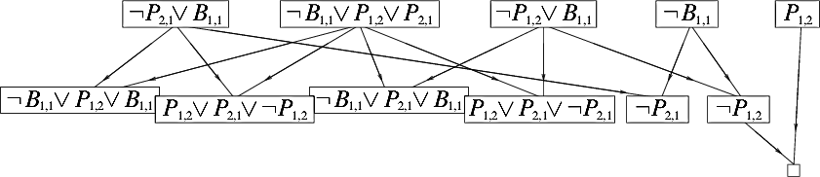
Proof by resolution
Resolution Algorithm:
α =￢P1,2
When we convert (KB ∧ ￢α) into CNF,
KB= (￢B1,1 ∨ P1,2 ∨ P2,1) ∧ (￢P1,2 ∨ B1,1) ∧ (￢P2,1) ∨ B1,1) ∧ (￢B1,1)
1
2
3
4
1 &2
1 & 2
2 & 3
2 & 3
1&4
3&4
So proved that α which is, say, ￢P1,2.(Not Pit in [ 1,2])
Mr. Prayag Patel
Department: IT/ICT-LJIET

Slide 91
Propositional theorem proving
Horn Clauses & definite clauses
Assistant Professor
IT-ICT Department, LJIET
prayag.patel@ljinstitutes.edu.in
Mr. Prayag Patel

Slide 92
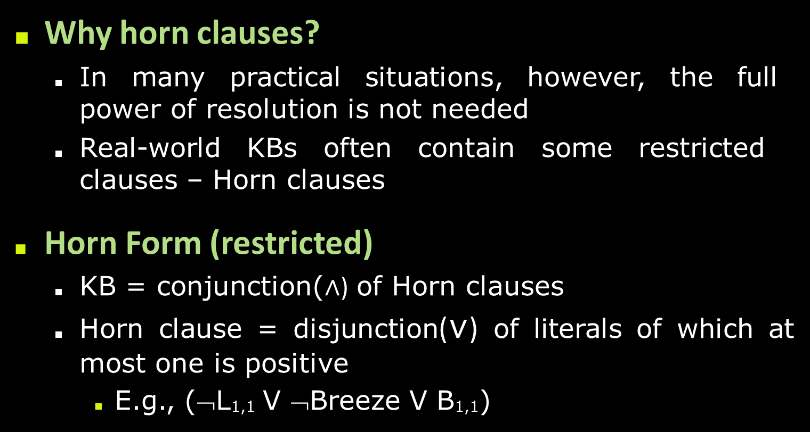
Horn Clauses & definite clauses
Why horn clauses?
  In many practical situations, however, the full power of resolution is not needed
  Real-world KBs often contain some restricted clauses – Horn clauses
Horn Form (restricted)
  KB = conjunction(∧) of Horn clauses
  Horn clause = disjunction($\text{∨}$) of literals of which at most one is positive
    E.g., (¬L_{1,1} V ¬Breeze V B_{1,1})
Mr. Prayag Patel
Department: IT/ICT-LJIET

Slide 93
Horn Clauses & definite clauses
Every horn clause can be written as an implication whose premise is a conjunction of positive literals and whose conclusion is a single positive literal
  E.g., (L1,1 ^ Breeze) ⇒ B1,1
The premise of the rule, which is a conjunction of positive literals, is called the body of the clause.
Also the conclusion is non-negated; it is called the head of the clause.
Mr. Prayag Patel
Department: IT/ICT-LJIET

Slide 94
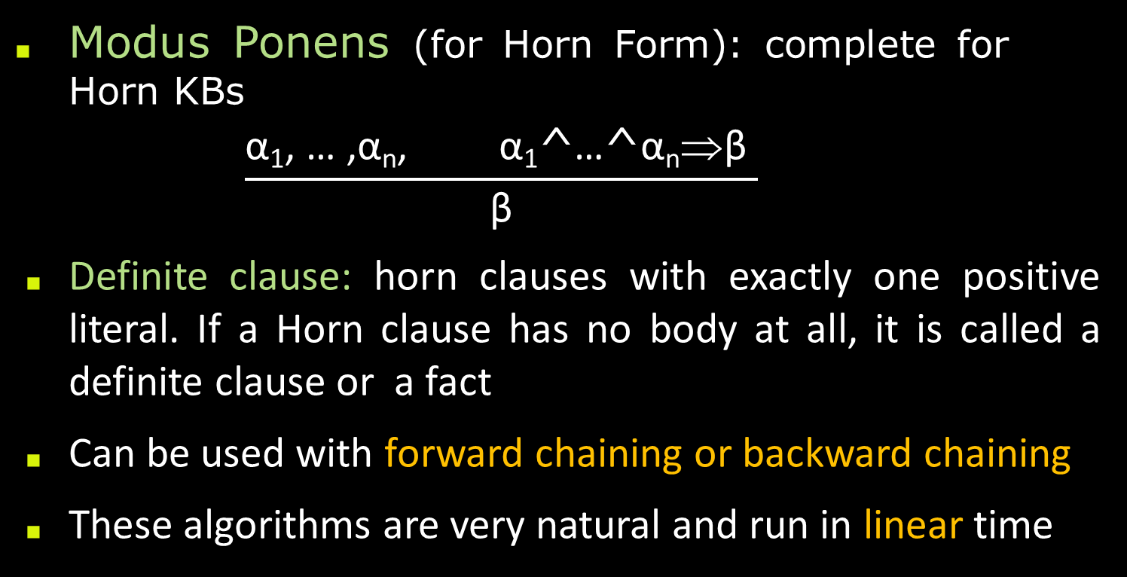
Horn Clauses & definite clauses
Modus Ponens (for Horn Form): complete for Horn KBs
    $$\frac{\text{α}\text{1}\text{,} \text{…} \text{,}\text{α}\text{n}\text{,} \text{α}\text{1}\text{^}\text{…}\text{^}\text{α}\text{n}\text{⇒}\text{β} }{\text{β}}$$
Definite clause: horn clauses with exactly one positive literal. If a Horn clause has no body at all, it is called a definite clause or a fact
Can be used with forward chaining or backward chaining
These algorithms are very natural and run in linear time
Mr. Prayag Patel
Department: IT/ICT-LJIET

Slide 95
Propositional theorem proving
Forward & backward chaining
Assistant Professor
IT-ICT Department, LJIET
prayag.patel@ljinstitutes.edu.in
Mr. Prayag Patel

Slide 96
Forward & backward chaining
Forward chaining is a method of reasoning in artificial intelligence in which inference rules are applied to existing data to extract additional data until an endpoint (goal) is achieved.
A simple example of forward chaining can be explained in the following sequence.
      A
      A->B
      B
A is the starting point. A->B represents a fact. This fact is used to achieve a decision B.
Mr. Prayag Patel
Department: IT/ICT-LJIET

Slide 97
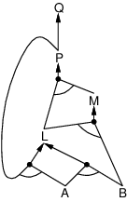
Forward & backward chaining
Forward chaining Idea: fire any rule whose premises are satisfied in the KB, add its conclusion to the KB, until query(Goal) is found.
P ⇒ Q
L ∧ M ⇒ P
B ∧ L ⇒ M
A ∧ P ⇒ L
A ∧ B ⇒ L
A
B
And-or graph
Mr. Prayag Patel
Department: IT/ICT-LJIET

Slide 98
Forward & backward chaining
Forward chaining :
Start with given proposition symbols (atomic sentence) e.g., A and B
Iteratively try to infer truth of additional proposition symbols
e.g., A ∧ B ⇒ C, therefor we establish C is true
Continue until:
  no more inference can be carried out, or
  goal is reached.
Mr. Prayag Patel
Department: IT/ICT-LJIET

Slide 99
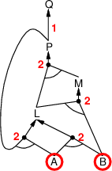
Forward & backward chaining
Forward chaining :
Given:
P ⇒ Q
L ∧ M ⇒ P
B ∧ L ⇒ M
A ∧ P ⇒ L
A ∧ B ⇒ L
A
B
Agenda: A, B
Mr. Prayag Patel
Department: IT/ICT-LJIET

Slide 100
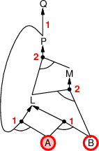
Forward & backward chaining
Forward chaining :
Process agenda item A
Decrease count for horn clauses in which A is premise
P ⇒ Q
L∧ M ⇒ P
B ∧ L ⇒ M
A ∧ P ⇒ L
A ∧ B ⇒ L
A
B
Mr. Prayag Patel
Department: IT/ICT-LJIET

Slide 101
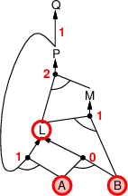
Forward & backward chaining
Forward chaining :
Process agenda item B
Decrease count for horn clauses in which B is premise
A ∧ B ⇒ L has now fulfilled premise
Add L to agenda
P ⇒ Q
L∧ M ⇒ P
B ∧ L ⇒ M
A ∧ P ⇒ L
A ∧ B ⇒ L
A
B
Mr. Prayag Patel
Department: IT/ICT-LJIET

Slide 102
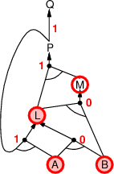
Forward & backward chaining
Forward chaining :
Process agenda item L
Decrease count for horn clauses in which L is premise
B ∧ L ⇒ M has now fulfilled premise
Add M to agenda
P ⇒ Q
L∧ M ⇒ P
B ∧ L ⇒ M
A ∧ P ⇒ L
A ∧ B ⇒ L
A
B
Mr. Prayag Patel
Department: IT/ICT-LJIET

Slide 103
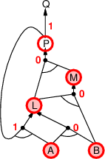
Forward & backward chaining
Forward chaining :
Process agenda item M
Decrease count for horn clauses in which M is premise
L ∧ M⇒ P has now fulfilled premise
Add P to agenda
P ⇒ Q
L∧ M ⇒ P
B ∧ L ⇒ M
A ∧ P ⇒ L
A ∧ B ⇒ L
A
B
Mr. Prayag Patel
Department: IT/ICT-LJIET

Slide 104
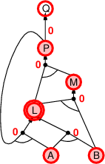
Forward & backward chaining
Forward chaining :
Process agenda item P
Decrease count for horn clauses in which P is premise
P⇒ Q has now fulfilled premise
Add Q to agenda
A ∧ P ⇒ L has now fulfilled premise
P ⇒ Q
L∧ M ⇒ P
B ∧ L ⇒ M
A ∧ P ⇒ L
A ∧ B ⇒ L
A
B
Mr. Prayag Patel
Department: IT/ICT-LJIET

Slide 105
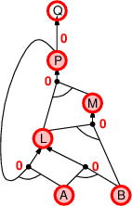
Forward & backward chaining
Forward chaining :
Process agenda item P
Decrease count for horn clauses in which P is premise
P ⇒ Q has now fulfilled premise
Add Q to agenda
A ∧ P ⇒ L has now fulfilled premise
But L is already inferred
P ⇒ Q
L∧ M ⇒ P
B ∧ L ⇒ M
A ∧ P ⇒ L
A ∧ B ⇒ L
A
B
Mr. Prayag Patel
Department: IT/ICT-LJIET

Slide 106
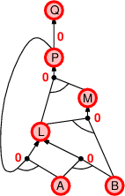
Forward & backward chaining
Forward chaining :
Process agenda item Q
Q is inferred
Done
P ⇒ Q
L∧ M ⇒ P
B ∧ L ⇒ M
A ∧ P ⇒ L
A ∧ B ⇒ L
A
B
Mr. Prayag Patel
Department: IT/ICT-LJIET

Slide 107
Forward & backward chaining
Forward chaining Algorithm :
function PL-FC-ENTAILS?(KB, q) returns true or false
inputs: KB, the knowledge base, a set of propositional Horn clauses
q, the query, a proposition symbol
count ←a table, where count [c] is the number of symbols in c’s premise
inferred ←a table,where inferred[s] is initially false for all symbols
agenda ←a queue of symbols, initially symbols known to be true in KB
while agenda is not empty do
p←POP(agenda)
if p = q then return true
if inferred[p] = false then
inferred[p]←true
for each clause c in KB where p is in c.PREMISE do
decrement count [c]
if count [c] = 0 then add c.CONCLUSION to agenda
return false
Mr. Prayag Patel

Slide 108
Forward & backward chaining
Backward chaining is a concept in artificial intelligence that involves backtracking from the endpoint or goal to steps that led to the endpoint.
This type of chaining starts from the goal and moves backward to comprehend the steps that were taken to attain this goal.
A simple example of for Backward chaining can be explained in the following sequence.
      B
      A->B
      A
B is the goal or endpoint, that is used as the starting point for backward tracking. A is the initial state. A->B is a fact that must be asserted to arrive at the endpoint B.
Mr. Prayag Patel
Department: IT/ICT-LJIET

Slide 109
Forward & backward chaining
Backward chaining Idea: work backwards from the query Q: to prove Q by Backward chaining.
check if Q is known already, or prove by Backward chaining all premises of some rule concluding q.
Avoid loops: check if new sub goal is already on the goal stack
Avoid repeated work: check if new sub goal
    has already been proved true, or
    has already failed
Mr. Prayag Patel
Department: IT/ICT-LJIET

Slide 110
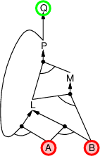
Forward & backward chaining
Backward chaining :
A and B are known to be true
Q needs to be proven
P ⇒ Q
L∧ M ⇒ P
B ∧ L ⇒ M
A ∧ P ⇒ L
A ∧ B ⇒ L
A
B
Mr. Prayag Patel
Department: IT/ICT-LJIET

Slide 111
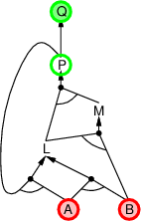
Forward & backward chaining
Backward chaining :
Current goal: Q
Q can be inferred by P ⇒ Q
P needs to be proven
P ⇒ Q
L∧ M ⇒ P
B ∧ L ⇒ M
A ∧ P ⇒ L
A ∧ B ⇒ L
A
B
Mr. Prayag Patel
Department: IT/ICT-LJIET

Slide 112
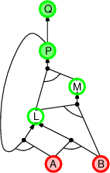
Forward & backward chaining
Backward chaining :
Current goal: P
P can be inferred by L ∧ M⇒ P
L and M need to be proven
P ⇒ Q
L∧ M ⇒ P
B ∧ L ⇒ M
A ∧ P ⇒ L
A ∧ B ⇒ L
A
B
Mr. Prayag Patel
Department: IT/ICT-LJIET

Slide 113
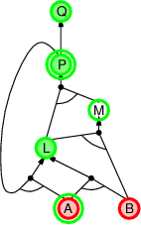
Forward & backward chaining
Backward chaining :
Current goal: L
L can be inferred by A ∧ P ⇒ L
A is already true
P is already a goal
⇒ repeated sub goal
P ⇒ Q
L∧ M ⇒ P
B ∧ L ⇒ M
A ∧ P ⇒ L
A ∧ B ⇒ L
A
B
Mr. Prayag Patel
Department: IT/ICT-LJIET

Slide 114
Forward & backward chaining
Backward chaining :
Current goal: L
P ⇒ Q
L∧ M ⇒ P
B ∧ L ⇒ M
A ∧ P ⇒ L
A ∧ B ⇒ L
A
B
Mr. Prayag Patel
Department: IT/ICT-LJIET

Slide 115
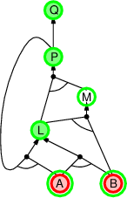
Forward & backward chaining
Backward chaining :
Current goal: L
L can be inferred by A ∧ B ⇒ L
Both are true
P ⇒ Q
L∧ M ⇒ P
B ∧ L ⇒ M
A ∧ P ⇒ L
A ∧ B ⇒ L
A
B
Mr. Prayag Patel
Department: IT/ICT-LJIET

Slide 116
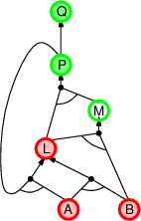
Forward & backward chaining
Backward chaining :
Current goal: L
L can be inferred by A ∧ B ⇒ L
Both are true
⇒ L is true
P ⇒ Q
L∧ M ⇒ P
B ∧ L ⇒ M
A ∧ P ⇒ L
A ∧ B ⇒ L
A
B
Mr. Prayag Patel
Department: IT/ICT-LJIET

Slide 117
Forward & backward chaining
Backward chaining :
Current goal: M
P ⇒ Q
L∧ M ⇒ P
B ∧ L ⇒ M
A ∧ P ⇒ L
A ∧ B ⇒ L
A
B
Mr. Prayag Patel
Department: IT/ICT-LJIET

Slide 118
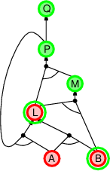
Forward & backward chaining
Backward chaining :
Current goal: M
M can be inferred by B∧L⇒ M
P ⇒ Q
L∧ M ⇒ P
B ∧ L ⇒ M
A ∧ P ⇒ L
A ∧ B ⇒ L
A
B
Mr. Prayag Patel
Department: IT/ICT-LJIET

Slide 119
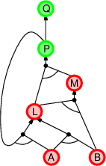
Forward & backward chaining
Backward chaining :
Current goal: M
M can be inferred by B∧L⇒ M
Both are true
⇒ M is true
P ⇒ Q
L∧ M ⇒ P
B ∧ L ⇒ M
A ∧ P ⇒ L
A ∧ B ⇒ L
A
B
Mr. Prayag Patel
Department: IT/ICT-LJIET

Slide 120
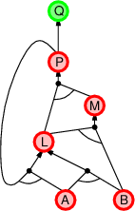
Forward & backward chaining
Backward chaining :
Current goal: P
P can be inferred by L ∧ M ⇒ P
Both are true
⇒ P is true
P ⇒ Q
L∧ M ⇒ P
B ∧ L ⇒ M
A ∧ P ⇒ L
A ∧ B ⇒ L
A
B
Mr. Prayag Patel
Department: IT/ICT-LJIET

Slide 121
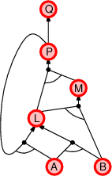
Forward & backward chaining
Backward chaining :
Current goal: Q
Q can be inferred by P ⇒ Q
P is true
⇒ Q is true
P ⇒ Q
L∧ M ⇒ P
B ∧ L ⇒ M
A ∧ P ⇒ L
A ∧ B ⇒ L
A
B
Mr. Prayag Patel
Department: IT/ICT-LJIET

Slide 122
Effective propositional model checking
Assistant Professor
IT-ICT Department, LJIET
prayag.patel@ljinstitutes.edu.in
Mr. Prayag Patel

Slide 123
Effective propositional model checking
The set of possible models, given a fixed propositional vocabulary, is finite, so entailment can be checked by enumerating models.
Efficient model-checking inference algorithms for propositional logic include backtracking and local search methods and can often solve large problems quickly.
Two families of algorithms for the SAT problem based on model checking:
Based on backtracking
Based on local hill-climbing search
Mr. Prayag Patel
Department: IT/ICT-LJIET

Slide 124
Effective propositional model checking
1) A complete backtracking algorithm:
The first algorithm we consider is often called the Davis– Putnam algorithm by Martin Davis and Hilary Putnam (1960).
The algorithm is in fact the version described by Davis, Logemann, and Loveland (1962), so we will call it DPLL.
DPLL takes as input a sentence in conjunctive normal form—a set of clauses.
Mr. Prayag Patel
Department: IT/ICT-LJIET

Slide 125
Effective propositional model checking
1) A complete backtracking algorithm:
DPLL embodies 3 improvements over the scheme of TT-ENTAILS?:
Early Termination:
The algorithm detects whether the sentence must be true or false, even with a partially completed model.
A clause is true if any literal is true, even if the other literals do not yet have truth values; hence, the sentence as a whole could be judged true even before the model is complete.
For example, the sentence (A ∨ B) ∧ (A ∨ C) is true if A is true, regardless of the values of B and C.
Similarly, a sentence is false if any clause is false, which occurs when each of its literals is false.
Early termination avoids examination of entire subtrees in the search space.
Mr. Prayag Patel
Department: IT/ICT-LJIET

Slide 126
Effective propositional model checking
1) A complete backtracking algorithm:
DPLL embodies 3 improvements over the scheme of TT-ENTAILS?:
2) Pure symbol heuristic :
A pure symbol is a symbol that always appears with the same “sign” in all clauses.
For example, in the three clauses (A ∨ ￢B), (￢B ∨ ￢C), and (C ∨ A), the symbol A is pure because only the positive literal appears, B is pure because only the negative literal appears, and C is impure.
It is easy to see that if a sentence has a model, then it has a model with the pure symbols assigned so as to make their literals true, because doing so can never make a clause false.
Mr. Prayag Patel
Department: IT/ICT-LJIET

Slide 127
Effective propositional model checking
1) A complete backtracking algorithm:
DPLL embodies 3 improvements over the scheme of TT-ENTAILS?:
3) Unit clause heuristic :
A unit clause was defined earlier as a clause with just one literal.
In the context of DPLL, it also means clauses in which all literals but one are already assigned false by the model.
For example, if the model contains B =true, then (￢B ∨ ￢C) simplifies to ￢C, which is a unit clause.
Obviously, for this clause to be true, C must be set to false.
Mr. Prayag Patel
Department: IT/ICT-LJIET

Slide 128
Effective propositional model checking
1) A complete backtracking algorithm:
function DPLL-SATISFIABLE?(s) returns true or false
inputs: s, a sentence in propositional logic
clauses ←the set of clauses in the CNF representation of s
symbols←a list of the proposition symbols in s
return DPLL(clauses, symbols,{ })
function DPLL(clauses, symbols,model ) returns true or false
if every clause in clauses is true in model then return true
if some clause in clauses is false in model then return false
P, value←FIND-PURE-SYMBOL(symbols, clauses,model )
if P is non-null then return DPLL(clauses, symbols – P,model ∪ {P=value})
P, value←FIND-UNIT-CLAUSE(clauses,model )
if P is non-null then return DPLL(clauses, symbols – P,model ∪ {P=value})
P ←FIRST(symbols); rest ←REST(symbols)
return DPLL(clauses, rest ,model ∪ {P=true}) or
DPLL(clauses, rest ,model ∪ {P=false}))
Mr. Prayag Patel
Department: IT/ICT-LJIET

Slide 129
Effective propositional model checking
1) A complete backtracking algorithm:
Tricks that enable SAT solvers to scale up to large problems:
Component analysis
Variable and value ordering
Intelligent backtracking
Random restarts
Clever indexing.
Mr. Prayag Patel
Department: IT/ICT-LJIET

Slide 130
Effective propositional model checking
2) Local search algorithms :
We have seen several local search algorithms so far including HILL-CLIMBING and SIMULATED-ANNEALING.
Local search algorithms can be applied directly to the SAT problem, provided that choose the right evaluation function. (We can choose an evaluation function that counts the number of unsatisfied clauses.)
These algorithms take steps in the space of complete assignments, flipping the truth value of one symbol at a time.
The space usually contains many local minima, to escape from which various forms of randomness are required.
Local search methods such as WALKSAT can be used to find solutions. Such algorithm are sound but not complete.
WALKSAT: one of the simplest and most effective algorithms.
Mr. Prayag Patel
Department: IT/ICT-LJIET

Slide 131
Effective propositional model checking
2) Local search algorithms :
On every iteration, the algorithm picks an unsatisfied clause and picks a symbol in the clause to flip.
It chooses randomly between two ways to pick which symbol to flip:
(1) a “min-conflicts” step that minimizes the number of unsatisfied clauses in the new state and
(2) a “random walk” step that picks the symbol randomly.
When the algorithm returns a model, the input sentence is indeed satisfiable; But When the algorithm returns failure, there are 2 possible causes: Either a. The sentence is unsatisfiable; Or b. We need to give the algorithm more time.
If we set max_flips=∞, p>0, the algorithm will: Either a. eventually return a model if one exists Or b. never terminate if the sentence is unsatisfiable.
Mr. Prayag Patel
Department: IT/ICT-LJIET

Slide 132
Effective propositional model checking
2) Local search algorithms :
Thus WALKSAT is useful when we expect a solution to exist, but cannot always detect unsatisfiability.
For example, an agent cannot reliably use WALKSAT to prove that a square is safe in the wumpus world.
Instead, it can say, “I thought about it for an hour and couldn’t come up with a possible world in which the square isn’t safe.”
This may be a good empirical indicator that the square is safe, but it’s certainly not a proof.
Mr. Prayag Patel
Department: IT/ICT-LJIET

Slide 133
Effective propositional model checking
2) Local search algorithms :
function WALKSAT(clauses, p,max flips) returns a satisfying model or failure
inputs: clauses, a set of clauses in propositional logic
p, the probability of choosing to do a “random walk” move, typically around 0.5
max flips, number of flips allowed before giving up
model ←a random assignment of true/false to the symbols in clauses
for i= 1 to max flips do
if model satisfies clauses then return model
clause←a randomly selected clause from clauses that is false in model
with probability p flip the value in model of a randomly selected symbol from clause
    else flip whichever symbol in clause maximizes the number of satisfied clauses
  return failure
Mr. Prayag Patel
Department: IT/ICT-LJIET

Slide 134
Effective propositional model checking
The Landscape of Random SAT Problem :
Some SAT problems are harder than others. Easy problems can be solved by any old algorithm, but because we know that SAT is NP-complete.
Underconstrained problem: When we look at satisfiability problems in CNF, an underconstrained problem is one with relatively few clauses constraining the variables.
For example, here is a randomly generated 3-CNF sentence with five symbols and five clauses:
(￢D ∨ ￢B ∨ C) ∧ (B ∨ ￢A∨ ￢C) ∧ (￢C ∨ ￢B ∨ E)∧ (E ∨ ￢D ∨ B) ∧ (B ∨ E ∨ ￢C)
m = number of clauses (5) n = number of symbols (5)
16 of 32 possible assignments above are solutions (so 2 random guesses will work on average)
Mr. Prayag Patel
Department: IT/ICT-LJIET

Slide 135
Effective propositional model checking
The Landscape of Random SAT Problem :
Overconstrained problem: On the other hand, an overconstrained problem has many clauses relative to the number of variables and is likely to have no solutions.
To go beyond these basic intuitions, we must define exactly how random sentences are generated.
The notation CNFk(m, n) denotes a k-CNF sentence with m clauses and n symbols, where the clauses are chosen uniformly, independently, and without replacement from among all clauses with k different literals, which are positive or negative at random.
Mr. Prayag Patel
Department: IT/ICT-LJIET

Slide 136
Effective propositional model checking
The Landscape of Random SAT Problem :
Given a source of random sentences, we can measure the probability of satisfiability.
Figure (a) plots the probability for CNF3(m, 50), that is, sentences with 50 variables and 3 literals per clause, as a function of the clause/symbol ratio, m/n.
As we expect, for small m/n the probability of satisfiability is close to 1, and at large m/n the probability is close to 0. The probability drops fairly sharply around m/n=4.3.
Mr. Prayag Patel
Department: IT/ICT-LJIET

Slide 137
Effective propositional model checking
The Landscape of Random SAT Problem :
Figure (b) shows that 50-symbol problems at the threshold value of 4.3 are about 20 times more difficult to solve than those at a ratio of 3.3.
Mr. Prayag Patel
Department: IT/ICT-LJIET

Slide 138
AGENTS BASED ON PROPOSITIONAL LOGIC
Assistant Professor
IT-ICT Department, LJIET
prayag.patel@ljinstitutes.edu.in
Mr. Prayag Patel

Slide 139
Agent based on Propositional Logic
We bring together what we have learned so far in order to construct Wumpus world agents that use propositional logic.
The agent needs to deduce the world given its percept.
We need a complete logical model.
We need agent can keep track of the world.
We show how the agent can use logical inference to construct plans that are guaranteed to achieve its goals.
Mr. Prayag Patel
Department: IT/ICT-LJIET

Slide 140
Agent based on Propositional Logic
1) The current state of the world:
A logical agent operates by deducing what to do from a knowledge base of sentences about the world.
The knowledge base is composed of axioms—general knowledge about how the world works—and percept sentences obtained from the agent’s experience in a particular world.
In wumpus world- The agent knows that the starting square contains no pit (￢P1,1) and no wumpus (￢W1,1).
Furthermore, for each square, it knows that the square is breezy if and only if a neighboring square has a pit; and a square is smelly if and only if a neighboring square has a wumpus.
Mr. Prayag Patel
Department: IT/ICT-LJIET

Slide 141
Agent based on Propositional Logic
1) The current state of the world:
A logical agent operates by deducing what to do from a knowledge base of sentences about the world.
Thus, we include a large collection of sentences of the following form:
B1,1 ⇔ (P1,2 ∨ P2,1)
S1,1 ⇔ (W1,2 ∨W2,1)
・ ・ ・
The agent also knows that there is exactly one Wumpus.
This is expressed in two parts. First, we have to say that there is at least one wumpus:
    W1,1 ∨W1,2 ∨ ・ ・ ・ ∨W4,3 ∨W4,4 .
Mr. Prayag Patel
Department: IT/ICT-LJIET

Slide 142
Agent based on Propositional Logic
1) The current state of the world:
Then, we have to say that there is at most one wumpus. For each pair of locations, we add a sentence saying that at least one of them must be wumpus-free:
    ￢W1,1 ∨ ￢W1,2
    ￢W1,1 ∨ ￢W1,3
    ・ ・ ・
Now let’s consider the agent’s percepts.
If there is currently a stench, one might suppose that a proposition Stench should be added to the knowledge base.
if the time step is 4, then we add Stench⁴ to the knowledge base, rather than Stench—neatly avoiding any contradiction with ￢Stench³
The same goes for the breeze, bump, glitter, and scream percepts.
Mr. Prayag Patel
Department: IT/ICT-LJIET

Slide 143
Agent based on Propositional Logic
1) The current state of the world:
For example, the initial knowledge base includes L⁰_{1,1}—the agent is in square [1, 1] at time 0—as well as FacingEast⁰ , HaveArrow⁰ , and WumpusAlive⁰ .
We use the word fluent to refer an aspect of the world that changes. “Fluent” is a synonym for “state variable”
Atemporal variables: Symbols associated with permanent aspects of the world do not need a time superscript and are sometimes called atemporal variables.
We can connect stench and breeze percepts directly to the properties of the squares where they are experienced through the location fluent as follows. For any time step t and any square [x, y], we assert
  L^{t}_{x,y} ⇒ (Breeze^{t} ⇔ B_{x,y} )
  L^{t}_{x,y} ⇒ (Stench^{t} ⇔ S_{x,y} )
Mr. Prayag Patel
Department: IT/ICT-LJIET

Slide 144
Agent based on Propositional Logic
1) The current state of the world:
Effect Axiom: To describe how the world changes, we can try writing effect axioms that specify the outcome of an action at the next time step.
For example, if the agent is at location [1, 1] facing east at time 0 and goes Forward , the result is that the agent is in square [2, 1] and no longer is in [1, 1]:
L⁰_{1,1} ∧ FacingEast⁰ ∧ Forward⁰ ⇒ (L¹_{2,1} ∧ ￢ L¹_{1,1} )
We would need one such sentence for each possible time step, for each of the 16 squares, and each of the four orientations.
We would also need similar sentences for the other actions: Grab, Shoot, Climb, TurnLeft, and TurnRight.
Mr. Prayag Patel
Department: IT/ICT-LJIET

Slide 145
Agent based on Propositional Logic
1) The current state of the world:
Frame Problem : The information has been lost because the effect axiom fails to state what remains unchanged as the result of an action. The need to do this gives rise to the frame problem.
FRAME AXIOM: One possible solution to the frame problem would be to add frame axioms explicitly asserting all the propositions that remain the same.
For example, for each time t we would have
Forward ^{t} ⇒ (HaveArrow ^{t} ⇔ HaveArrow ^{t+1} )
Forward ^{t} ⇒ (WumpusAlive ^{t} ⇔ WumpusAlive ^{t+1} )
Mr. Prayag Patel
Department: IT/ICT-LJIET

Slide 146
Agent based on Propositional Logic
1) The current state of the world:
Representation frame problem: In a world with m different actions and n fluents, the set of frame axioms will be of size O(mn). This specific manifestation of the frame problem is sometimes called the representational frame problem.
Solution: because the world exhibits locality (for humans each action typically changes no more than some number k of those fluents.) Define the transition model with a set of axioms of size O(mk) rather than size O(mn).
Mr. Prayag Patel
Department: IT/ICT-LJIET

Slide 147
Agent based on Propositional Logic
1) The current state of the world:
Inferential frame problem: The problem of projecting forward the results of a t step plan of action in time O(kt) rather than O(nt).
Solution: change one’s focus from writing axioms about actions to writing axioms about fluents.
For each fluent F, we will have an axiom that defines the truth value of F ^{t + 1} in terms of fluents at time t and the action that may have occurred at time t.
The truth value of F ^{t + 1} can be set in one of 2 ways:
a. The action at time t cause F to be true at t+1 or
b. F was already true at time t and the action at time t does not cause it to be false.
An axiom of this form is called a successor-state axiom and has this schema: F ^{t + 1} ⇔ ActionCauses F ^{t} ∨ (F ^{t} ∧ ￢ActionCausesNot F ^{t} )
Mr. Prayag Patel
Department: IT/ICT-LJIET

Slide 148
Agent based on Propositional Logic
1) The current state of the world:
The initial sequence of percepts and actions is:
￢Stench⁰ ∧ ￢Breeze⁰ ∧￢Glitter ⁰ ∧ ￢Bump⁰ ∧ ￢Scream⁰ ;Forward ⁰
￢Stench¹ ∧ Breeze¹ ∧￢Glitter ¹ ∧ ￢Bump¹ ∧ ￢Scream¹ ; TurnRight¹
￢Stench² ∧ Breeze² ∧￢Glitter ² ∧ ￢Bump² ∧ ￢Scream² ; TurnRight²
￢Stench³ ∧ Breeze³ ∧￢Glitter ³ ∧ ￢Bump³ ∧ ￢Scream³ ; Forward ³
￢Stench⁴ ∧ ￢Breeze⁴ ∧￢Glitter ⁴ ∧ ￢Bump⁴ ∧ ￢Scream⁴;TurnRight⁴
￢Stench⁵ ∧ ￢Breeze⁵ ∧￢Glitter ⁵ ∧ ￢Bump⁵ ∧ ￢Scream⁵ ; Forward ⁵
Stench⁶ ∧ ￢Breeze⁶ ∧￢Glitter ⁶ ∧ ￢Bump⁶ ∧ ￢Scream⁶
Mr. Prayag Patel
Department: IT/ICT-LJIET

Slide 149
Agent based on Propositional Logic
1) The current state of the world:
Qualification Problem : We said that the Forward action moves the agent ahead unless there is a wall in the way, but there are many other unusual exceptions that could cause the action to fail: the agent might trip and fall, be stricken with a heart attack, be carried away by giant bats, etc. Specifying all QUALIFICATION these exceptions is called the qualification problem.
Mr. Prayag Patel
Department: IT/ICT-LJIET

Slide 150
Agent based on Propositional Logic
2) Hybrid Agent:
Hybrid agent: combines the ability to deduce various aspect of the state of the world with condition-action rules, and with problem-solving algorithms.
The agent maintains and update KB as a current plan.
The initial KB contains the atemporal axioms. (don’t depend on t)
At each time step, the new percept sentence is added along with all the axioms that depend on t (such as the successor-state axioms).
Then the agent use logical inference by ASKING questions of the KB (to work out which squares are safe and which have yet to be visited).
Mr. Prayag Patel
Department: IT/ICT-LJIET

Slide 151
Agent based on Propositional Logic
2) Hybrid Agent:
The main body of the agent program constructs a plan based on a decreasing priority of goals:
If there is a glitter, construct a plan to grab the gold, follow a route back to the initial location and climb out of the cave;
Otherwise if there is no current plan, plan a route (with A* search) to the closest safe square unvisited yet, making sure the route goes through only safe squares;
If there are no safe squares to explore, if still has an arrow, try to make a safe square by shooting at one of the possible wumpus locations.
If this fails, look for a square to explore that is not provably unsafe.
If there is no such square, the mission is impossible, then retreat to the initial location and climb out of the cave.
Mr. Prayag Patel
Department: IT/ICT-LJIET

Slide 152
Agent based on Propositional Logic
2) Hybrid Agent:
function HYBRID-WUMPUS-AGENT(percept ) returns an action
inputs: percept , a list, [stench,breeze,glitter ,bump,scream]
persistent:KB, a knowledge base, initially the atemporal “Wumpus physics”
t , a counter, initially 0, indicating time
plan, an action sequence, initially empty
TELL(KB,MAKE-PERCEPT-SENTENCE(percept , t ))
TELL the KB the temporal “physics” sentences for time t
safe ←{[x , y] : ASK(KB,OK^{t}_{x,y}) = true}
if ASK(KB,Glitter^{t}) = true then
plan ←[Grab] + PLAN-ROUTE(current , {[1,1]}, safe) + [Climb]
if plan is empty then
unvisited ←{[x , y] : ASK(KB,L^{t’}_{x,y}) = false for all t’ ≤ t}
plan ←PLAN-ROUTE(current, unvisited ∩safe, safe)
Mr. Prayag Patel
Department: IT/ICT-LJIET

Slide 153
Agent based on Propositional Logic
2) Hybrid Agent:
if plan is empty and ASK(KB,HaveArrow^{t}) = true then
possible wumpus ←{[x , y] : ASK(KB,￢W_{x,y}) = false}
plan ←PLAN-SHOT(current , possible wumpus, safe)
if plan is empty then // no choice but to take a risk
not unsafe ←{[x , y] : ASK(KB,￢ OK^{t}_{x,y}) = false}
plan ←PLAN-ROUTE(current, unvisited ∩not unsafe, safe)
if plan is empty then
plan ←PLAN-ROUTE(current, {[1, 1]}, safe) + [Climb]
action ←POP(plan)
TELL(KB,MAKE-ACTION-SENTENCE(action, t ))
t ←t + 1
return action
Mr. Prayag Patel

Slide 154
Agent based on Propositional Logic
2) Hybrid Agent:
function PLAN-ROUTE(current,goals,allowed) returns an action sequence
inputs: current , the agent’s current position
goals, a set of squares; try to plan a route to one of them
allowed, a set of squares that can form part of the route
problem ←ROUTE-PROBLEM(current , goals,allowed)
return A*-GRAPH-SEARCH(problem)
Mr. Prayag Patel
Department: IT/ICT-LJIET

Slide 155
Agent based on Propositional Logic
3) Logical State Estimation:
To get a constant update time, we need to cache the result of inference.(next step can build on the result of earlier steps instead of having to start again from scratch)
Belief state: Some representation of the set of all possible current state of the world. (used to replace the past history of percepts and all their ramifications)
WumpusAlive¹ ∧ L¹_{2,1} ∧ B_{2,1} ∧ (P_{3,1} ∨ P_{2,2})
Represents the set of all states at time 1 in which the wumpus is alive, the agent is at [2, 1], that square is breezy, and there is a pit in [3, 1] or [2, 2] or both.
Mr. Prayag Patel
Department: IT/ICT-LJIET

Slide 156
Agent based on Propositional Logic
3) Logical State Estimation:
We use a logical sentence involving the proposition symbols associated with the current time step and the temporal symbols.
Logical state estimation involves maintaining a logical sentence that describes the set of possible states consistent with the observation history. Each update step requires inference using the transition model of the environment, which is built from successor-state axioms that specify how each fluent changes.
State estimation: The process of updating the belief state as new percepts arrive.
Exact state estimation may require logical formulas whose size is exponential in the number of symbols.
Mr. Prayag Patel
Department: IT/ICT-LJIET

Slide 157
Agent based on Propositional Logic
3) Logical State Estimation:
One common scheme for approximate state estimation: to represent belief state as conjunctions of literals (1-CNF formulas).
The agent simply tries to prove X^{t} and ¬X^{t} for each symbol X^{t}, given the belief state at t-1.
The conjunction of provable literals becomes the new belief state, and the previous belief state is discarded.(This scheme may lose some information as time goes along.)
The set of possible states represented by the 1-CNF belief state includes all states that are in fact possible given the full percept history. The 1-CNF belief state acts as a simple outer envelope, or conservative approximation.
Mr. Prayag Patel
Department: IT/ICT-LJIET

Slide 158
Agent based on Propositional Logic
3) Logical State Estimation:
Depiction of a 1-CNF belief state (bold outline) as a simply representable, conservative approximation to the exact (wiggly) belief state (shaded region with dashed outline). Each possible world is shown as a circle; the shaded ones are consistent with all the percepts.
Mr. Prayag Patel
Department: IT/ICT-LJIET

Slide 159
Agent based on Propositional Logic
4) Making plans by propositional inference:
Basic idea:
Construct a sentence that includes:
  Init⁰: a collection of assertions about the initial state;
  Transition¹, …, Transition^{t}: The successor-state axioms for all possible actions at each time up to some maximum time t;
  HaveGold^{t}∧ClimbedOut^{t}: The assertion that the goal is achieved at time t.
Present the whole sentence to a SAT solver. If the solver finds a satisfying model, the goal is achievable; else the planning is impossible.
Assuming a model is found, extract from the model those variables that represent actions and are assigned true. Together they represent a plan to achieve the goals.
Mr. Prayag Patel
Department: IT/ICT-LJIET

Slide 160
Agent based on Propositional Logic
4) Making plans by propositional inference:
Decisions within a logical agent can be made by SAT solving: finding possible models specifying future action sequences that reach the goal. This approach works only for fully observable or sensor less environment.
SATPLAN: A propositional planning. (Cannot be used in a partially observable environment)
SATPLAN finds models for a sentence containing the initial sate, the goal, the successor-state axioms, and the action exclusion axioms.
(Because the agent does not know how many steps it will take to reach the goal, the algorithm tries each possible number of steps t up to some maximum conceivable plan length T_{max}.)
Mr. Prayag Patel
Department: IT/ICT-LJIET

Slide 161
Agent based on Propositional Logic
4) Making plans by propositional inference:
function SATPLAN(init , transition, goal , Tmax) returns solution or failure
inputs: init , transition, goal , constitute a description of problem
Tmax, an upper limit for plan length
for t = 0 to Tmax do
cnf ←TRANSLATE-TO-SAT(init , transition, goal , t )
model ←SAT-SOLVER(cnf )
if model is not null then
return EXTRACT-SOLUTION(model )
return failure
Mr. Prayag Patel
Department: IT/ICT-LJIET

Slide 162
Agent based on Propositional Logic
4) Making plans by propositional inference:
Precondition axioms: stating that an action occurrence requires the preconditions to be satisfied, added to avoid generating plans with illegal actions.
Action exclusion axioms: added to avoid the creation of plans with multiple simultaneous actions that interfere with each other.
Propositional logic does not scale to environments of unbounded size because it lacks the expressive power to deal concisely with time, space and universal patterns of relationships among objects.
Mr. Prayag Patel
Department: IT/ICT-LJIET

Slide 163
FIRST ORDER LOGIC
Assistant Professor
IT-ICT Department, LJIET
prayag.patel@ljinstitutes.edu.in
Mr. Prayag Patel

Slide 164
Outline
Representation Revisited
Syntax and Semantics of First Order Logic
Using First Order Logic
Mr. Prayag Patel
Department: IT/ICT-LJIET

Slide 165
Representation Revisited
Assistant Professor
IT-ICT Department, LJIET
prayag.patel@ljinstitutes.edu.in
Mr. Prayag Patel

Slide 166
Representation Revisited
In the Propositional logic, we have seen that how to represent statements using propositional logic.
But unfortunately, in propositional logic, we can only represent the facts, which are either true or false. PL is not sufficient to represent the complex sentences or natural language statements.
The propositional logic has very limited expressive power. Consider the following sentence, which we cannot represent using PL logic.
  "Some humans are intelligent", or "Sachin likes cricket.“
To represent the above statements, PL logic is not sufficient, so we required some more powerful logic, such as first-order logic.
Mr. Prayag Patel
Department: IT/ICT-LJIET

Slide 167
Representation Revisited
Propositional logic is declarative: pieces of syntax correspond to facts.
Propositional logic allows partial / disjunctive / negated information (unlike most data structures and databases)
Meaning in propositional logic is context-independent
(unlike natural language, where meaning depends on context)
Propositional logic has very limited expressive power
(unlike natural language)
E.g., cannot say “if any student sits an exam they either pass or fail”.
Mr. Prayag Patel
Department: IT/ICT-LJIET

Slide 168
Representation Revisited
Propositional logic is compositional
(meaning of B ^ P is derived from meaning of B and of P)
Propositional logic lacks the expressive power to describe an environment with many objects concisely.
For example, we were forced to write a separate rule about breezes and pits for each square, such as
B 1,1⇔(P 1,2 or P 2,1)
In English, on the other hand, it seems easy enough to say, once and for all, ”Squares adjacent to pits are breezy”
Mr. Prayag Patel
Department: IT/ICT-LJIET

Slide 169
Representation Revisited
Natural languages are also non compositional the meaning of a sentence such as “Then she saw it” can depend on a context constructed by many preceding and succeeding sentences.
Finally, natural languages suffer from ambiguity, which would cause difficulties for thinking.
Mr. Prayag Patel
Department: IT/ICT-LJIET

Slide 170
Representation Revisited
First-order logic is another way of knowledge representation in artificial intelligence. It is an extension to propositional logic.
FOL is sufficiently expressive to represent the natural language statements in a concise way.
First-order logic is also known as Predicate logic or First-order predicate logic.
First-order logic is a powerful language that develops information about the objects in a more easy way and can also express the relationship between those objects.
Mr. Prayag Patel
Department: IT/ICT-LJIET

Slide 171
Representation Revisited
First-order logic (like natural language) does not only assume that the world contains facts like propositional logic but also assumes the following things in the world:
  Objects (Nouns and Noun phases): A, B, people, numbers, colors, wars, theories, squares, pits, wumpus,…
  Relations(Verbs and Verb Phases): It can be unary relation such as: red, round, is adjacent, or n-any relation such as: the sister of, brother of, has color, comes between….
  Function: Father of, best friend, third inning of, end of, …
Mr. Prayag Patel
Department: IT/ICT-LJIET

Slide 172
Representation Revisited
Ex.: “One plus two equals three.”
Objects: one, two, three, one plus two;
Relation: equals;
Function: plus. (“One plus two” is a name for the object that is obtained by applying the function “plus” to the objects “one” and “two.” “Three” is another name for this object.)
Mr. Prayag Patel
Department: IT/ICT-LJIET

Slide 173
Representation Revisited
Propositional logic assumes that there are facts that either hold or do not hold.
FOL assumes more: the world consists of objects with certain relations among them that do or do not hold.
Temporal logic: facts hold at particular times / T,F,U
  E.g., “I am always hungry”, “I will eventually be hungry”
Higher-order logic: views the relations and functions in FOL as objects themselves / T,F,U
  Probability theory: facts / degree of belief [0, 1]
  Fuzzy logic: facts with degree of truth [0, 1] / known interval values
      E.g,“the temperature is very hot, hot, normal, cold, very cold”
Mr. Prayag Patel
Department: IT/ICT-LJIET

Slide 174
Representation Revisited
Formal languages and their ontological and epistemological commitments.
Language | Ontological Commitment (What exists in the world) | Epistemological Commitment(What an agent believes about facts)
Propositional logic | facts | true/false/unknown
First-order logic | facts, objects, relations | true/false/unknown
Temporal logic | facts, objects, relations, times | true/false/unknown
Probability theory | facts | degree of belief ∈ [0, 1]
Fuzzy logic | facts with degree of truth ∈ [0, 1] | known interval value
Mr. Prayag Patel
Department: IT/ICT-LJIET

Slide 175
Syntax and Semantics of First Order Logic
Assistant Professor
IT-ICT Department, LJIET
prayag.patel@ljinstitutes.edu.in
Mr. Prayag Patel

Slide 176
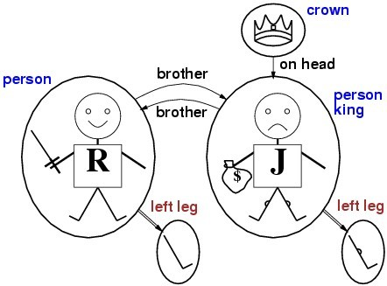
Syntax and Semantics of First Order Logic
Models for First Order Logic:
The models of a logical language are the formal structures that constitute the possible worlds under consideration.
Models for first-order logic are more interesting.
The domain of a model is the set of objects it contains ; these objects are sometimes called domain elements.
figure shows a model with five objects: The objects in the model may be related in various ways.
Mr. Prayag Patel
Department: IT/ICT-LJIET

Slide 177
Syntax and Semantics of First Order Logic
Models for First Order Logic:
In the figure, Richard and john are brothers.
Formally speaking , a relation is just the set of tuples of objects that are related.(A tuple is a collection of objects arranged in a fixed order and is written with angle brackets surrounding the object relation).
The crown is on king John’s head, so the “on head”‖ relation contains just one tuple,{ the crown, king john}.
The “brother”‖ and “on head” relations are binary relations—that is, they relate pairs of objects.
Mr. Prayag Patel
Department: IT/ICT-LJIET

Slide 178
Syntax and Semantics of First Order Logic
Models for First Order Logic:
Five objects:
Richard the Lionheart
Evil King John
Left leg of Richard
Left leg of John
The crown
Mr. Prayag Patel
Department: IT/ICT-LJIET

Slide 179
Syntax and Semantics of First Order Logic
Models for First Order Logic:
Two Binary Relations:
King John and Richard are related with Brother relationship
The crown and King John are related with OnHead Relationship.
Mr. Prayag Patel
Department: IT/ICT-LJIET

Slide 180
Syntax and Semantics of First Order Logic
Models for First Order Logic:
Three Unary Relations:
Richard is Person
John is Person
John is King
Functions: Means one object is related with exactly one object.
Richard -> Richard’s left leg
John -> John’s left leg
Mr. Prayag Patel
Department: IT/ICT-LJIET

Slide 181
Syntax and Semantics of First Order Logic
Symbols and Interpretations:
The basic syntactic elements of first-order logic are the symbols that stand for objects, relations and functions.
The symbols, therefore , come in three kinds:
Constant symbols, which stand for objects;
Predicate symbols , which stand for relations; and
Function symbols , which stand for functions.
We adopt the convention that these symbols will begin with uppercase letters.
For example, we might use the constant symbols Richard and John; the predicate symbols Brother, OnHead, Person, King , and Crown ; and the function symbol LeftLeg.
Mr. Prayag Patel
Department: IT/ICT-LJIET

Slide 182
Syntax of FOL: Basic Elements
Syntax and Semantics of First Order Logic
Symbols and Interpretations:
Constants
Predicates
Functions
Variables
Connectives
Equality
Quantifiers
KingJohn, 2, NUS,...
Brother, >,...
Sqrt, LeftLegOf,...
x, y, a, b,...
¬, ⇒, ∧, ∨, ⇔
=
∀, ∃
Mr. Prayag Patel
Department: IT/ICT-LJIET

Slide 183
Intended Interpretation:
Syntax and Semantics of First Order Logic
Symbols and Interpretations:
The semantics relate sentences to models to determine truth
Interpretation specifies exactly which objects, relations and functions are referred to by the constant, predicate, and function symbols
Richard refers to Richard the Lionheart and John refers to the evil King John.
Brother refers to the brotherhood relation; OnHead refers to the “on head” relation that holds between the crown and King John; Crown refer to the set of objects that are crowns.
LeftLeg refers to the “left leg” function.
Mr. Prayag Patel
Department: IT/ICT-LJIET

Slide 184
Example:
Syntax and Semantics of First Order Logic
Symbols and Interpretations:
King John and Richard the Lion heart are brothers
Brother(KingJohn,RichardTheLionheart)
The length of left leg of Richard is greater than the length of left leg of King John
>(Length(LeftLegOf(Richard)),Length(LeftLegOf(KingJohn)))
Mr. Prayag Patel
Department: IT/ICT-LJIET

Slide 185
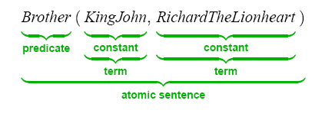
Term: Term refers to an object. (Constant or Variable)
Syntax and Semantics of First Order Logic
predicate (term₁,...,term_{n})
Mr. Prayag Patel
Department: IT/ICT-LJIET

Slide 186
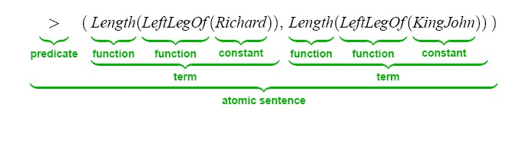
Atomic Sentences: Atomic sentences are the most basic sentences of first-order logic. These sentences are formed from a predicate(Relation) symbol followed by a parenthesis with a sequence of terms.
Syntax and Semantics of First Order Logic
predicate (term₁,...,term_{n})
Mr. Prayag Patel
Department: IT/ICT-LJIET

Slide 187
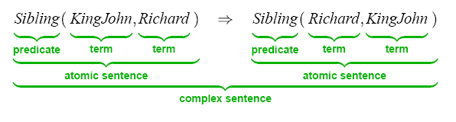
Complex Sentences: Complex sentences are made by combining atomic sentences using connectives.
S₁ ∧ S₂ , S₁ ∨ S₂ , S₁ ⇒ S₂ , S₁ ⇔ S₂
Syntax and Semantics of First Order Logic
¬Brother (LeftLeg(Richard), John)
Brother (Richard, John) ∧ Brother (John, Richard)
King(Richard) ∨ King(John)
¬King(Richard) ⇒ King(John)
Mr. Prayag Patel
Department: IT/ICT-LJIET

Slide 188
Quantifiers:
Syntax and Semantics of First Order Logic
A quantifier is a language element which generates quantification, and quantification specifies the quantity of specimen in the universe of discourse.
These are the symbols that permit to determine or identify the range and scope of the variable in the logical expression.
There are two types of quantifier:
Universal Quantifier, (for all, everyone, everything)
Existential quantifier, (for some, at least one)
Mr. Prayag Patel
Department: IT/ICT-LJIET

Slide 189
Quantifiers:
Syntax and Semantics of First Order Logic
Universal Quantifier (∀) (for all, everyone, everything)
Universal quantifier is a symbol of logical representation, which specifies that the statement within its range is true for everything or every instance of a particular thing.
The Universal quantifier is represented by a symbol ∀, which resembles an inverted A.
If x is a variable, then ∀x is read as:
For all x
For each x
For every x
The main connective for universal quantifier ∀ is implication ⇒ OR →.
Mr. Prayag Patel
Department: IT/ICT-LJIET

Slide 190
Quantifiers:
Syntax and Semantics of First Order Logic
Universal Quantifier (∀) (for all, everyone, everything)
∀<variables> <sentence> => ∀x P(x)
“All kings are persons” is written in first-order logic as :
∀x King(x) ⇒ Person(x)
For all x, if x is a king, then x is a person.
Remember, we had five objects, let us replace them with a variable x-
x ―›Richard the Lionheart
x ―› Evil King John
x ―› Left leg of Richard
x ―› Left leg of John
x ―› The crown
Mr. Prayag Patel
Department: IT/ICT-LJIET

Slide 191
Quantifiers:
Syntax and Semantics of First Order Logic
Universal Quantifier (∀)
Now, for the quantified sentence
∀x King (x) ⇒ Person (x)
Richard is king ⇒ Richard is Person
John is king ⇒ John is person
Richard’s left leg is king ⇒ Richard’s left leg is person
John’s left leg is king ⇒ John’s left leg is person
The crown is king ⇒ the crown is person
Only the second sentence is correct, the rest is incorrect
Mr. Prayag Patel
Department: IT/ICT-LJIET

Slide 192
Quantifiers:
Syntax and Semantics of First Order Logic
2) Existential Quantifier (∃) (for some, at least one)
Existential quantifiers are the type of quantifiers, which express that the statement within its scope is true for at least one instance of something.
It is denoted by the logical operator ∃, which resembles as inverted E. When it is used with a predicate variable then it is called as an existential quantifier.
If x is a variable, then existential quantifier will be ∃x or ∃(x). And it will be read as:
There exists a 'x.'
For some 'x.'
For at least one 'x.'
The main connective for existential quantifier ∃ is and ∧.
Mr. Prayag Patel
Department: IT/ICT-LJIET

Slide 193
Quantifiers:
Syntax and Semantics of First Order Logic
2) Existential Quantifier (∃) (for some, at least one)
∃ <variables> <sentence> => ∃ x P(x)
∃x: boys(x) ∧ intelligent(x)
It will be read as: There are some x where x is a boy who is intelligent.
Ex: “King John has a crown on his head”
we write ∃ x Crown(x) ⇒ OnHead(x, John)
There exists an x such that x is a crown and x is on the John’s head.
∃x is pronounced “There exists an x such that . . .” or “For some x . . .”
Mr. Prayag Patel
Department: IT/ICT-LJIET

Slide 194
Quantifiers:
Syntax and Semantics of First Order Logic
2) Existential Quantifier (∃) (for some, at least one)
That is, at least one of the following is true:
Richard the Lionheart is a crown ∧ Richard the Lionheart is on John’s head;
King John is a crown ∧ King John is on John’s head;
Richard’s left leg is a crown ∧ Richard’s left leg is on John’s head;
John’s left leg is a crown ∧ John’s left leg is on John’s head;
The crown is a crown ∧ the crown is on John’s head.
Only the fifth sentence is correct, the rest is incorrect
Mr. Prayag Patel
Department: IT/ICT-LJIET

Slide 195
Quantifiers:
Syntax and Semantics of First Order Logic
3) Nested Quantifier
We will often want to express more complex sentences using multiple quantifiers
“Brothers are siblings” can be written as
∀ x ∀ y Brother (x, y) ⇒ Sibling(x, y)
Consecutive quantifiers of the same type can be written as one quantifier with several variables. For example, to say that siblinghood is a symmetric relationship, we can write
∀ x, y Sibling(x, y) ⇔ Sibling(y, x)
Mr. Prayag Patel
Department: IT/ICT-LJIET

Slide 196
Quantifiers:
Syntax and Semantics of First Order Logic
3) Nested Quantifier
we will have mixtures. “Everybody loves somebody”‖ means that for every person, there is someone that person loves:
∀ x ∃ y Loves(x, y)
On the other hand, to say “There is someone who is loved by everyone”‖ we write
∃ y ∀ x Loves(x, y) .
In universal quantifier, ∀x∀y is similar to ∀y∀x.
In Existential quantifier, ∃x∃y is similar to ∃y∃x.
∃x∀y is not similar to ∀y∃x.
Mr. Prayag Patel
Department: IT/ICT-LJIET

Slide 197
Quantifiers:
Syntax and Semantics of First Order Logic
Connections between ∀ and ∃:
The two quantifiers are actually intimately connected with each other, through negation. Asserting that everyone dislikes parsnips is the same as asserting there does not exist someone who likes them, and vice versa:
∀ x ¬Likes(x,Parsnips ) is equivalent to ¬∃x Likes(x,Parsnips) .
We can go one step further: “Everyone likes ice cream”‖ means that there is no one who does not like ice cream:
∀ x Likes(x,IceCream) is equivalent to ¬∃ x ¬Likes(x,IceCream) .
Mr. Prayag Patel
Department: IT/ICT-LJIET

Slide 198
Quantifiers:
Syntax and Semantics of First Order Logic
Connections between ∀ and ∃:
The De Morgan rules for quantified and unquantified sentences are as follows:
∀ x ¬P ≡ ¬∃ x P ¬(P ∨ Q) ≡ ¬P ∧ ¬Q
¬∀ x P ≡ ∃ x ¬P ¬(P ∧ Q) ≡ ¬P ∨ ¬Q
∀ x P ≡ ¬∃ x ¬P P ∧ Q ≡ ¬(¬P ∨ ¬Q)
∃ x P ≡ ¬∀ x ¬P P ∨ Q ≡ ¬(¬P ∧ ¬Q) .
Mr. Prayag Patel
Department: IT/ICT-LJIET

Slide 199
Equality:
Syntax and Semantics of First Order Logic
We can use the Equality symbol to signify that two terms refer to the same object. For example,
Father (John) = Henry
Says that the object referred to by Father (John) and the object referred to by Henry are the same.
It can also be used with negation to insist that two terms are not the same object. To say that Richard has at least two brothers, we would write
∃ x, y Brother (x, Richard) ∧ Brother (y, Richard) ∧ ¬(x = y).
The notation x ≠ y is sometimes used as an abbreviation for ￢(x=y).
Mr. Prayag Patel
Department: IT/ICT-LJIET

Slide 200
Syntax of FOL
Syntax and Semantics of First Order Logic
Mr. Prayag Patel
Department: IT/ICT-LJIET

Slide 201
Using First Order Logic
Assistant Professor
IT-ICT Department, LJIET
prayag.patel@ljinstitutes.edu.in
Mr. Prayag Patel

Slide 202
Assertions and queries in first-order logic:
Using First Order Logic
We begin with a brief description of the TELL/ASK interface for first-order knowledge bases.
Sentences are added to a knowledge base using TELL, exactly as in propositional logic. Such sentences are called assertions.
For example, ASSERTION we can assert that John is a king, Richard is a person, and all kings are persons:
TELL(KB, King(John)) .
TELL(KB, Person(Richard)) .
TELL(KB, ∀ x King(x) ⇒ Person(x)) .
Mr. Prayag Patel
Department: IT/ICT-LJIET

Slide 203
Assertions and queries in first-order logic:
Using First Order Logic
We can ask questions of the knowledge base using ASK.
For example: ASK(KB, King(John))
QUERY returns true.
Questions asked with ASK are called queries or goals.
If we ask: ASK(KB, Person(John))
Then should also return true.
Mr. Prayag Patel
Department: IT/ICT-LJIET

Slide 204
Assertions and queries in first-order logic:
Using First Order Logic
We can ask quantified queries, such as
ASK(KB, ∃ x Person(x))
The answer is true, is asking “Is there an x such that……..”
The standard form for an answer is a substitution or binding list, which is a set of variable/term pairs, the answer would be {x/John}.
Mr. Prayag Patel
Department: IT/ICT-LJIET

Slide 205
The Kinship(Family Relationship) Domain:
Using First Order Logic
We consider is the domain of family relationships.
Object: people
Unary predicate: Male, Female
Binary predicate: Son, Spouse, Wife, Husband, Grandparent, Grandchild, Cousin, Aunt, and Uncle
Function: Mother, Father(because every person has exactly one of each of these)
Kinship relations: parenthood, brotherhood, marriage…
Mr. Prayag Patel
Department: IT/ICT-LJIET

Slide 206
The Kinship(Family Relationship) Domain:
Using First Order Logic
For example:
1) one’s mother is one’s female parent:
∀ m, c Mother (c) = m ⇔ Female(m) ∧ Parent(m, c) .
2) One’s husband is one’s male spouse:
∀ w, h Husband(h, w) ⇔ Male(h) ∧ Spouse(h, w) .
3) Male and female are disjoint categories:
∀ x Male(x) ⇔ ¬Female(x) .
Mr. Prayag Patel
Department: IT/ICT-LJIET

Slide 207
The Kinship(Family Relationship) Domain:
Using First Order Logic
For example:
4) Parent and child are inverse relations:
∀ p, c Parent(p, c) ⇔ Child(c, p) .
5) A grandparent is a parent of one’s parent:
∀ g, c Grandparent(g, c) ⇔ ∃ p Parent(g, p) ∧ Parent(p, c) .
6) A sibling is another child of one’s parents:
∀ x, y Sibling(x, y) ⇔ x ≠ y ∧ ∃ p Parent(p, x) ∧ Parent(p, y)
Mr. Prayag Patel
Department: IT/ICT-LJIET

Slide 208
The Kinship(Family Relationship) Domain:
Using First Order Logic
Each of these sentences can be viewed as an axiom of the kinship domain.
Axioms are commonly associated with purely mathematical domains. Our kinship axioms are also definitions.
Not all logical sentences about a domain are axioms. Some are theorems.
For example: consider the assertion that siblinghood is symmetric:
∀ x, y Sibling(x, y) ⇔ Sibling(y, x) .
In fact, it is a theorem that follows logically from the axiom that defines siblinghood.
Mr. Prayag Patel
Department: IT/ICT-LJIET

Slide 209
The Kinship(Family Relationship) Domain:
Using First Order Logic
From a practical point of view, theorems are essential to reduce the computational cost of deriving new sentences.
Not all axioms are definitions.
Some provide more general information about certain predicates without constituting a definition.
Actually, some predicates have no complete definition because we do not know enough to characterize them fully.
For example: there is no obvious definitive way to complete the sentence :
∀ x Person(x) ⇔ ...
Mr. Prayag Patel
Department: IT/ICT-LJIET

Slide 210
The Kinship(Family Relationship) Domain:
Using First Order Logic
Fortunately, first-order logic allows us to make use of the Person predicate without completely defining it.
Instead, we can write partial specifications of properties that every person has and properties that make something a person:
∀ x Person(x) ⇒ ...
∀ x ... ⇒ Person(x) .
Axioms can also be “just plain facts”,‖ such as Male(Jim) and Spouse(Jim, Rina).
Mr. Prayag Patel
Department: IT/ICT-LJIET

Slide 211
Numbers, Sets and Lists:
Using First Order Logic
Numbers are perhaps the most vivid example of how a large theory can be built up from a small kernel of axioms.
We describe here the theory of natural numbers or non-negative integers.
We need a predicate NatNum that will be true of natural numbers.
we need one constant symbol, 0; and we need one function symbol, S (successor).
NatNum(0) .
∀ n NatNum(n) ⇒ NatNum(S(n)) .
Mr. Prayag Patel
Department: IT/ICT-LJIET

Slide 212
Numbers, Sets and Lists:
Using First Order Logic
NatNum(0) and ∀ n NatNum(n) ⇒ NatNum(S(n)) .
That is, 0 is a natural number, and for every object n, if n is a natural number, then S(n) is a natural number.
So the natural numbers are 0, S(0), S(S(0)), and so on.
We also need axioms to constrain the successor function:
∀ n 0 ≠ S(n) .
∀ m, n m ≠ n ⇒ S(m) ≠ S(n) .
Now we can define addition in terms of the successor function:
∀ m NatNum(m) ⇒ + (0, m) = m .
∀ m, n NatNum(m) ∧ NatNum(n) ⇒ + (S(m), n) = S(+(m, n))
Mr. Prayag Patel
Department: IT/ICT-LJIET

Slide 213
Numbers, Sets and Lists:
Using First Order Logic
∀ m NatNum(m) ⇒ + (0, m) = m .
∀ m, n NatNum(m) ∧ NatNum(n) ⇒ + (S(m), n) = S(+(m, n))
The first of these axioms says that adding 0 to any natural number m gives m itself.
Notice the use of the binary function symbol “+” in the term +(m, 0); in ordinary mathematics, the INFIX term would be written m + 0 using infix notation. (The notation we have used for first-order logic is called prefix.)
We can also write S(n) as n+ 1, so the second axiom becomes
∀ m,n NatNum(m) ∧ NatNum(n) ⇒ (m + 1) + n = (m + n) + 1
Mr. Prayag Patel
Department: IT/ICT-LJIET

Slide 214
Numbers, Sets and Lists:
Using First Order Logic
The use of infix notation is an example of syntactic sugar, that is, an extension to or abbreviation of the standard syntax that does not change the semantics.
We will use the normal vocabulary of set theory as syntactic sugar. The empty set is a constant written as { }.
There is one unary predicate set which is true of sets.
The binary predicates are x∈ s and S₁ ⊆ S₂ The binary functions are S₁ ∩ S₂, S₁ ∪ S₂, and {x|s} (Means the set resulting from adjoining element x to set s)
Mr. Prayag Patel
Department: IT/ICT-LJIET

Slide 215
Numbers, Sets and Lists:
Using First Order Logic
One possible set of axioms is as follows:
1) The only sets are the empty set and those made by adjoining something to a set:
∀ s Set(s) ⇔ (s = { }) ∨ (∃ x, s₂ Set(s₂) ∧ s = {x| s₂}) .
2) The empty set has no elements adjoined into it. In other words, there is no way to decompose { } into a smaller set and an element:
¬∃ x, s {x|s} = { } .
3) Adjoining an element already in the set has no effect:
∀ x, s x∈ s ⇔ s = {x|s} .
Mr. Prayag Patel
Department: IT/ICT-LJIET

Slide 216
Numbers, Sets and Lists:
Using First Order Logic
4) The only members of a set are the elements that were adjoined into it. We express this recursively, saying that x is a member of s if and only if s is equal to some set S₂ adjoined with some element y, where either y is the same as x or x is a member of S₂ :
∀ x, s x∈ s ⇔ ∃ y, s₂ (s = {y| s₂} ∧ (x = y ∨ x∈ s₂)) .
5) A set is a subset of another set if and only if all of the first set’s members are members of the second set:
∀ s₁, s₂ s₁ ⊆ s₂ ⇔ (∀ x x∈ s₁ ⇒ x∈ s₂) .
6) Two sets are equal if and only if each is a subset of the other:
∀ s₁, s₂ (s₁ = s₂) ⇔ (s₁ ⊆ s₂ ∧ s₂ ⊆ s₁) .
Mr. Prayag Patel
Department: IT/ICT-LJIET

Slide 217
Numbers, Sets and Lists:
Using First Order Logic
7) An object is in the intersection of two sets if and only if it is a member of both sets:
∀ x, s₁, s₂ x∈ (s₁ ∩ s₂) ⇔ (x∈ s₁ ∧ x∈ s₂) .
8) An object is in the union of two sets if and only if it is a member of either set:
∀ x, s₁, s₂ x∈ (s₁ ∪ s₂) ⇔ (x∈ s₁ ∨ x∈ s₂) .
Mr. Prayag Patel
Department: IT/ICT-LJIET

Slide 218
Numbers, Sets and Lists:
Using First Order Logic
Lists are similar to sets.
The differences are that lists are ordered and the same element can appear more than once in a list.
We can use the vocabulary of Lisp for lists:
Nil is the constant list with no elements;
Cons, Append, First, and Rest are functions;
Find is the predicate that does for lists what Member does for sets.
Mr. Prayag Patel
Department: IT/ICT-LJIET

Slide 219
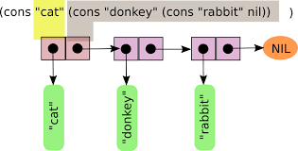
Numbers, Sets and Lists:
Using First Order Logic
Cons takes two arguments, an element and a list and returns a list with the element inserted at the first place.
The empty list is [ ].
The term Cons(x, y), where y is a nonempty list, is written [x|y].
The term Cons(x, Nil) (i.e., the list containing the element x) is written as [x].
A list of several elements, such as [A,B,C], corresponds to the nested term Cons(A, Cons(B, Cons(C, Nil))).
Mr. Prayag Patel

Slide 220
The Wumpus World:
Using First Order Logic
A percept is a binary predicate:
  Percept([Stench, Breeze, Glitter, None, None], 5)
Actions are logical terms:
  Turn(Right), Turn(Left), Forward, Shoot, Grab, Release, Climb
Query:
  ASKVARS (∃ a BestAction(a, 5))
  Answer: {a/Grab}
Perception: percept implies facts:
  ∀ t, s, b, m, c Percept([s, b, Glitter, m, c], t) ⇒ Glitter(t)
Reflex behavior:
  ∀ t Glitter(t) ⇒ BestAction(Grab, t)
Mr. Prayag Patel
Department: IT/ICT-LJIET

Slide 221
The Wumpus World:
Using First Order Logic
The Environment:
Objects: squares, pits and the Wumpus
∀ x,y,a,b Adjacent([x,y],[a,b]) ⇔ [a,b]∈ {[x+1,y], [x-1,y],[x,y+1], [x,y-1]}
A unary predicate Pit(x)
∀ s,t At(Agent,s,t) ∧ Breeze(t) ⇒ Breezy(s), the agent infers properties of the square from properties of its current percept
Breezy() has no time argument
Having discovered which places are breezy or smelly, not breezy or not smelly, the agent can deduce where the pits are and where the wumpus is
Mr. Prayag Patel
Department: IT/ICT-LJIET

Slide 222
The Wumpus World:
Using First Order Logic
Diagnostic rule: lead from observed effects to hidden causes
  If the square is breezy then adjacent square(s) must contain a pit
∀s Breezy(s) ⇒ ∃ r Adjacent(r,s) ∧ Pit(r)
  If the square is not breezy, no adjacent square contains a pit
∀s ¬Breezy(s) ⇒ ¬ (∃ r Adjacent(r,s) ∧ Pit(r))
  Combining both:
∀s Breezy(s) ⇔ ∃ r Adjacent(r,s) ∧ Pit(r)
Mr. Prayag Patel
Department: IT/ICT-LJIET

Slide 223
The Wumpus World:
Using First Order Logic
Causal rule: some hidden property of the world causes certain percept to be generated
A pit causes all adjacent squares to be breezy
∀ r Pit(r) ⇒ [∀ s Adjacent(r,s) ⇒ ∀ Breezy(s)]
If all squares adjacent to a given square are pitless, the square will not be breezy
∀ s [∀ r [Adjacent(r,s) ⇒ ¬ Pit(r)]] ⇒ ¬ Breezy(s)
Mr. Prayag Patel
Department: IT/ICT-LJIET

Slide 224
Thank you for watching ..
Mr. Prayag Patel
Prayag.patel@ljinstitutes.edu.in

